Slide 1
DEPARTMENT OF COMPUTER SCIENCE · COMSATS UNIVERSITY ISLAMABAD
PropBot
Alina Raza
CIIT/FA23-BSE-015/ISB
AI-Powered RFP and Proposal Automation Platform for Telecom Presales Teams
Anna Munir
CIIT/FA23-BSE-019/ISB
Software Requirements Specification · FYP-I
Ayesha Noor
CIIT/FA23-BSE-025/ISB
Project Supervisor
Dr. Memoona Malik
Start →
BS Software Engineering (2023–2027)

Slide 2
CONTENTS
Presentation Contents
01 Introduction: Project, Problem and Users
05 Requirement Elicitation and Techniques
02 Proposed Solution and Workflow
06 Use Case Diagram and Actors
03 Evaluation Feedback and Our Response
07 Key Mockups with FRs and Rules
04 Modules and Main FRs
08 Non-Functional Requirements
PropBot · SRS Presentation 2

Slide 3
INTRODUCTION
Project Overview
PropBot is a web platform with a companion Android app that takes a telecom RFP from upload to a verified, ready-to-submit bid package.
18
modules
It reads the RFP, builds the checklist and compliance matrix, drafts the proposal from the company’s own past work, fills the BOQ and network diagram, and blocks submission until everything required is in place.
5
user roles
WHAT PROPBOT PRODUCES
118
Submission checklist
Compliance matrix
Technical proposal
Bill of Quantities
functional requirements
HLD diagram
Responsibility matrix
ZIP package
Web + Android
one backend, one set of roles
PropBot · SRS Presentation 3
← Back
Contents
Next →

Slide 4
INTRODUCTION
Problem Statement
Problem
What it costs
Telecom RFPs are long and mix technical, commercial, financial and legal content in one file.
Presales engineers prepare the checklist, compliance sheet, BOQ, network diagram and proposal by hand for every bid.
Work is spread across laptops, spreadsheets and email; reviews and approvals also happen by email.
Several RFPs run at once, each with its own closing date.
One RFP response takes 3–7 days of manual work.
One missing mandatory document can cost the whole bid.
One wrong compliance rating can disqualify the bid.
Proposal knowledge is lost when experienced engineers leave.
Approvals stall when reviewers are away from their desks.
Goal: turn a 3–7 day manual process into a guided workflow of under 8 hours, with nothing missed at submission.
PropBot · SRS Presentation 4
← Back
Contents
Next →

Slide 5
INTRODUCTION
Target Users and Impact
Presales Engineer
Reviewer
Org Admin
Super Admin
Read-only User
Main user: RFPs, checklist, compliance, proposal, BOQ, HLD, package
Approves sections or requests changes, on web or mobile
Users, templates, knowledge base, audit log, analytics
Creates company workspaces on the platform
Searches and views past projects in the vault
Why it matters
Faster bids: a guided workflow instead of 3–7 days of manual work (target under 8 hours, BO-1).
Fewer lost bids: mandatory documents and NC items are checked before the package can be built.
Knowledge stays: every approved proposal is stored and reused for the next bid.
Accountability: every action is recorded, and nobody can approve their own work.
PropBot · SRS Presentation 5
← Back
Contents
Next →

Slide 6
PROPOSED SOLUTION
Proposed Solution: One Workflow from RFP to Submission
Rule-based (same answer every time)
AI-assisted (drafts or extracts)
Human decision
1
2
3
4
5
6
7
Upload RFP
Checklist
Compliance
Proposal
BOQ and HLD
Review
Readiness and package
Local models classify sections and pull out key facts
AI lists required documents; engineer ticks them off
Rule engine rates FC / PC / NC with evidence
RAG draft from the company’s approved proposals
Templates filled; diagram drawn and described
Reviewer approves every section; no self-approval
Blockers stop the ZIP; package saved in the vault
The LLM only drafts and extracts text. Rules and people decide compliance, approval and readiness.
PropBot · SRS Presentation 6
← Back
Contents
Walkthrough
Next →

Slide 7
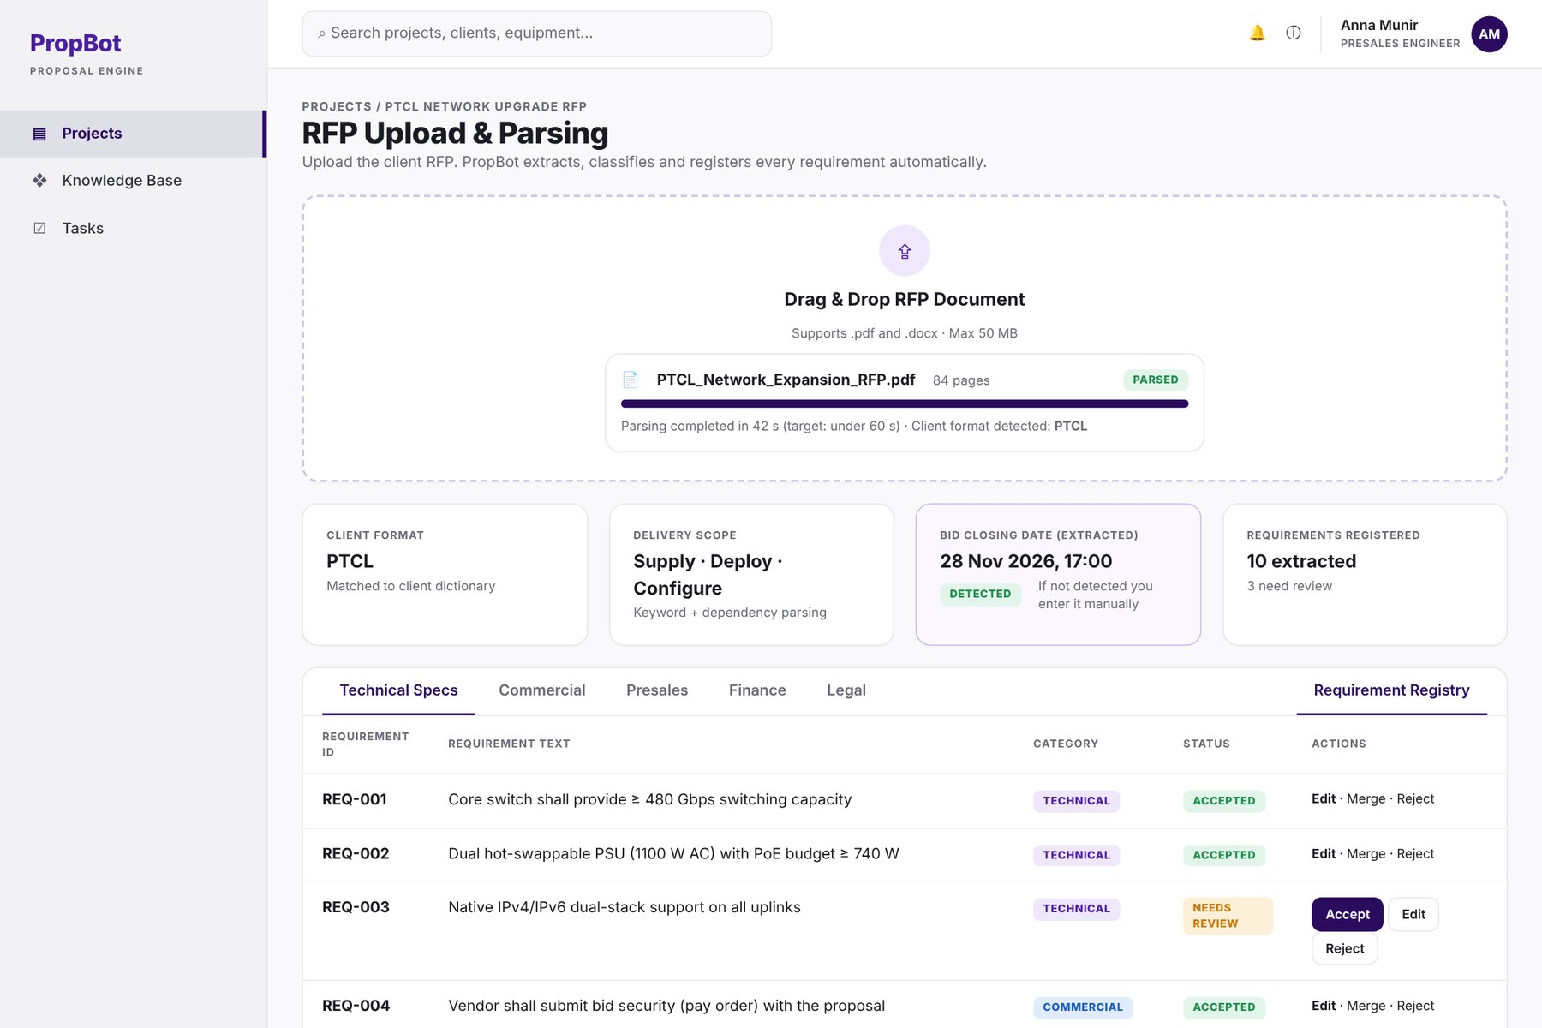
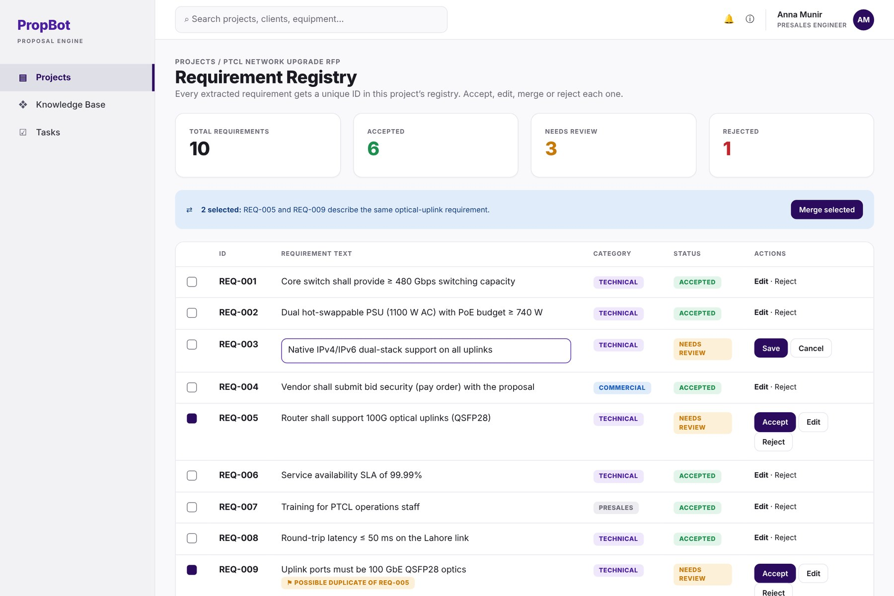
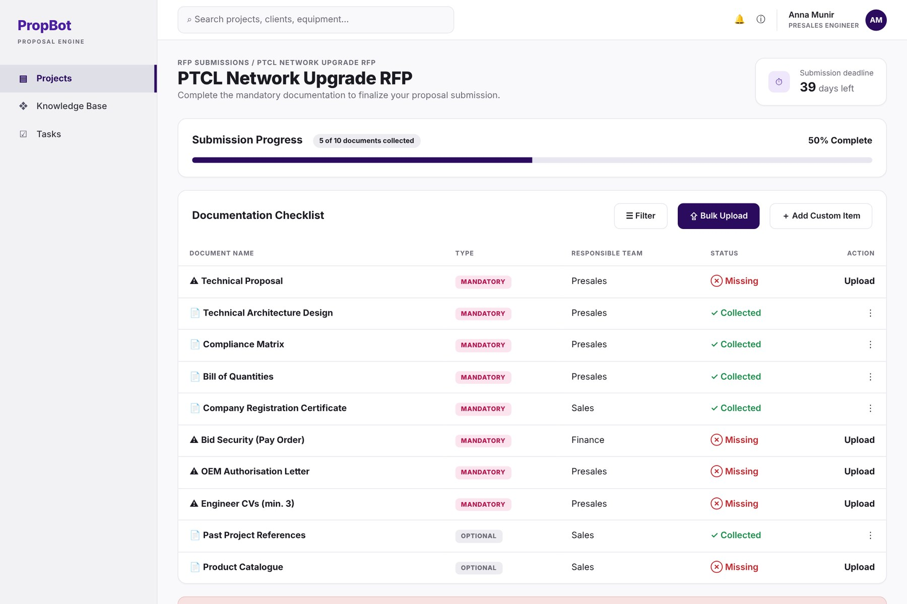
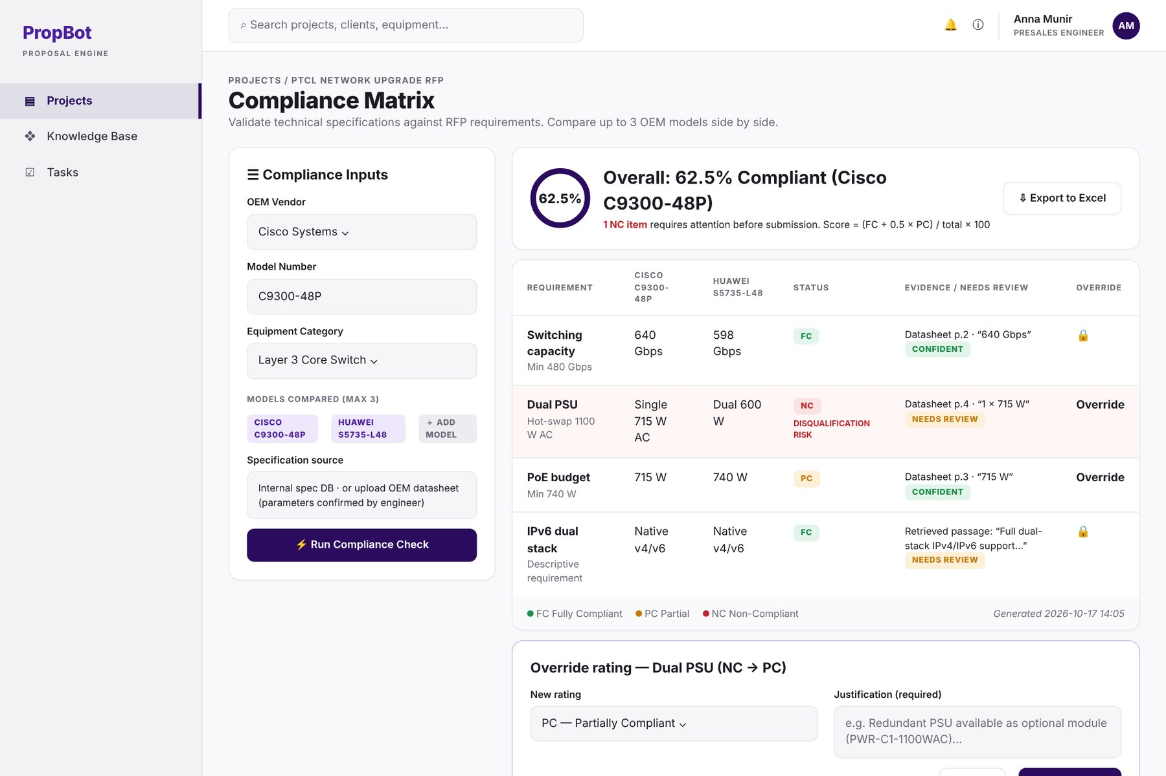
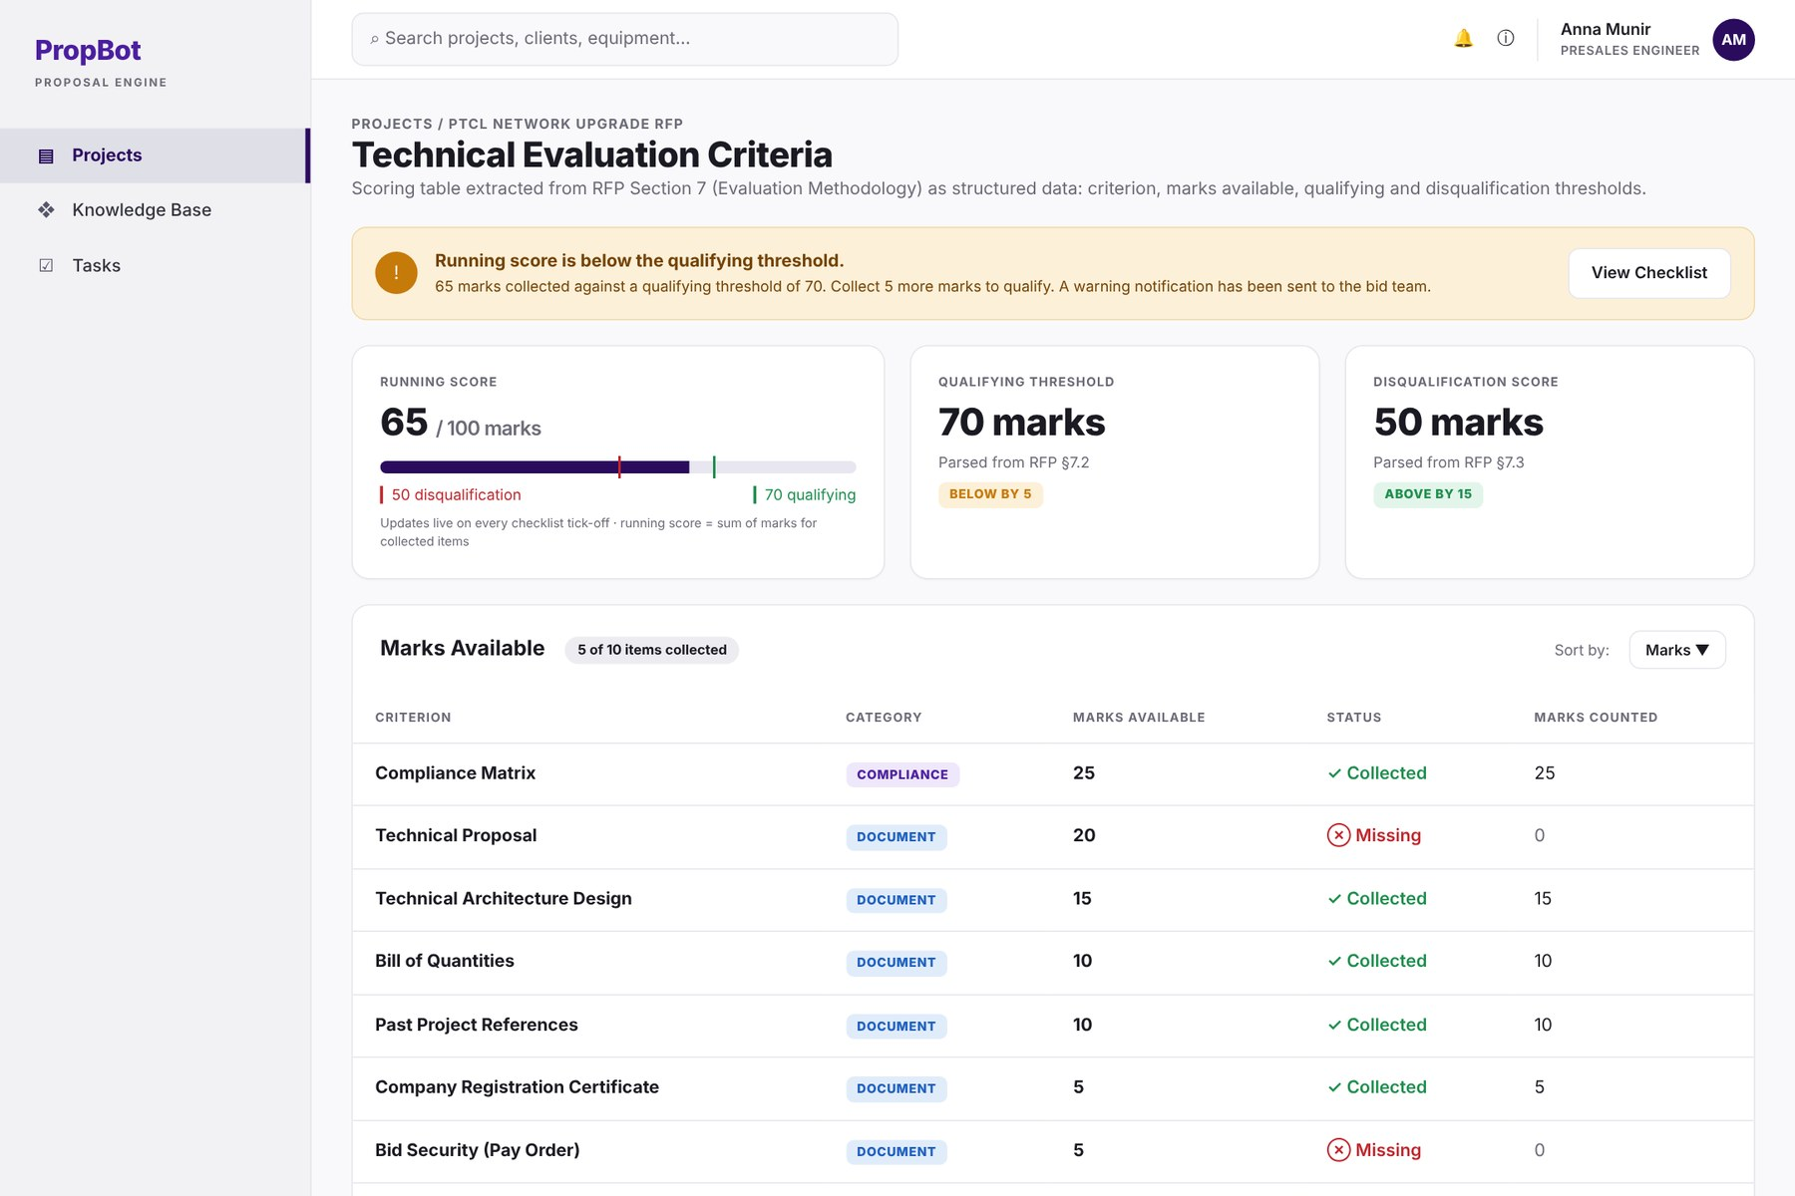
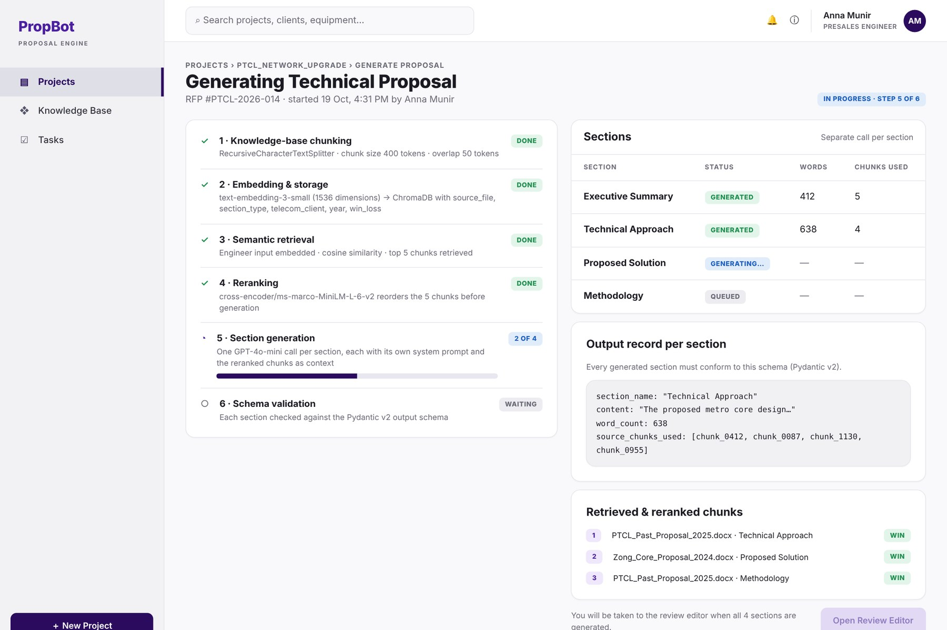
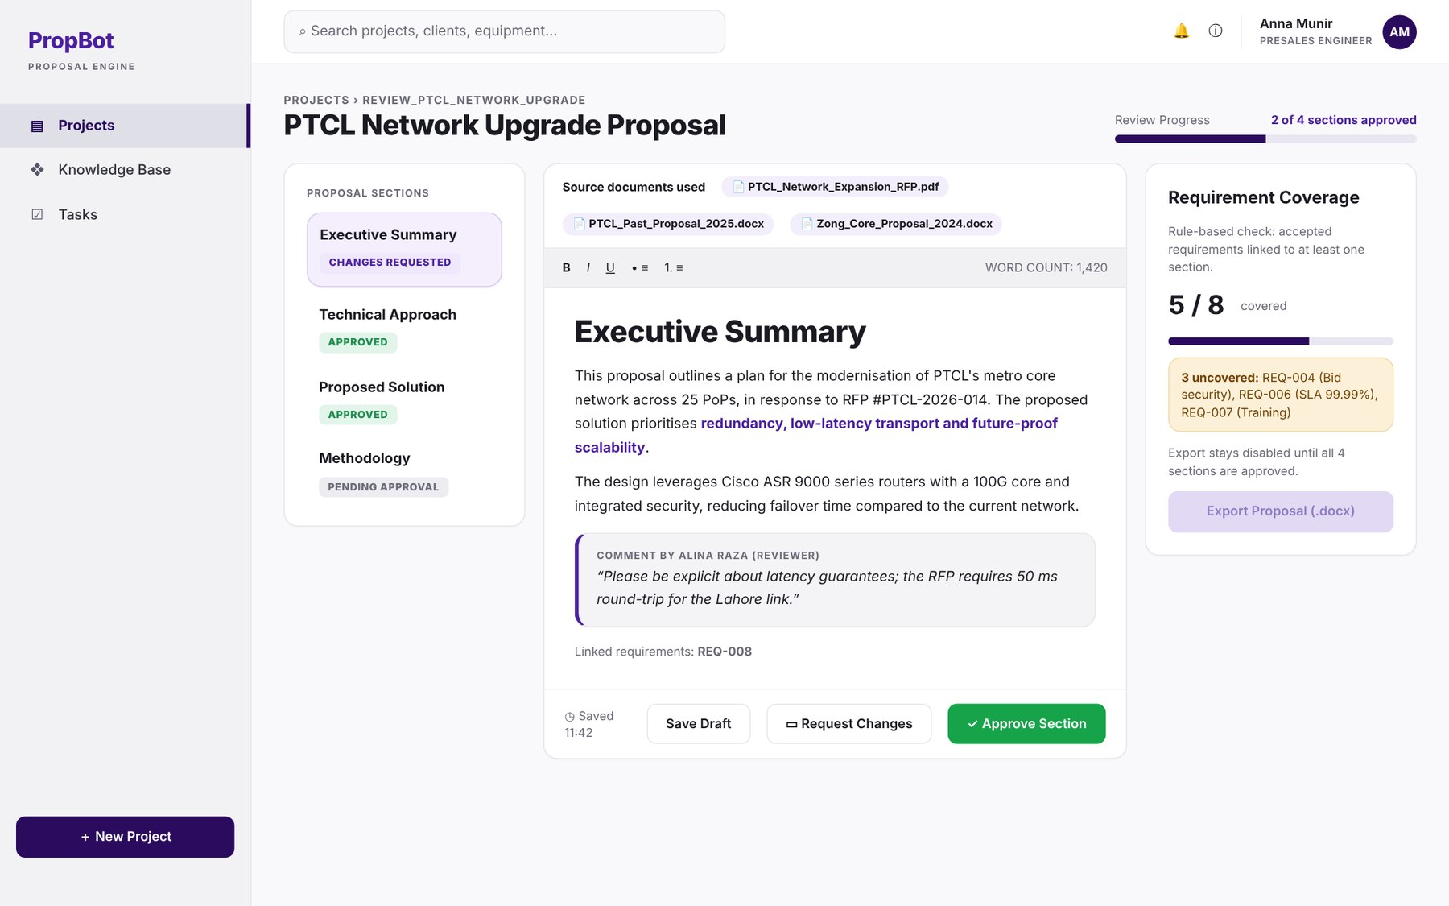
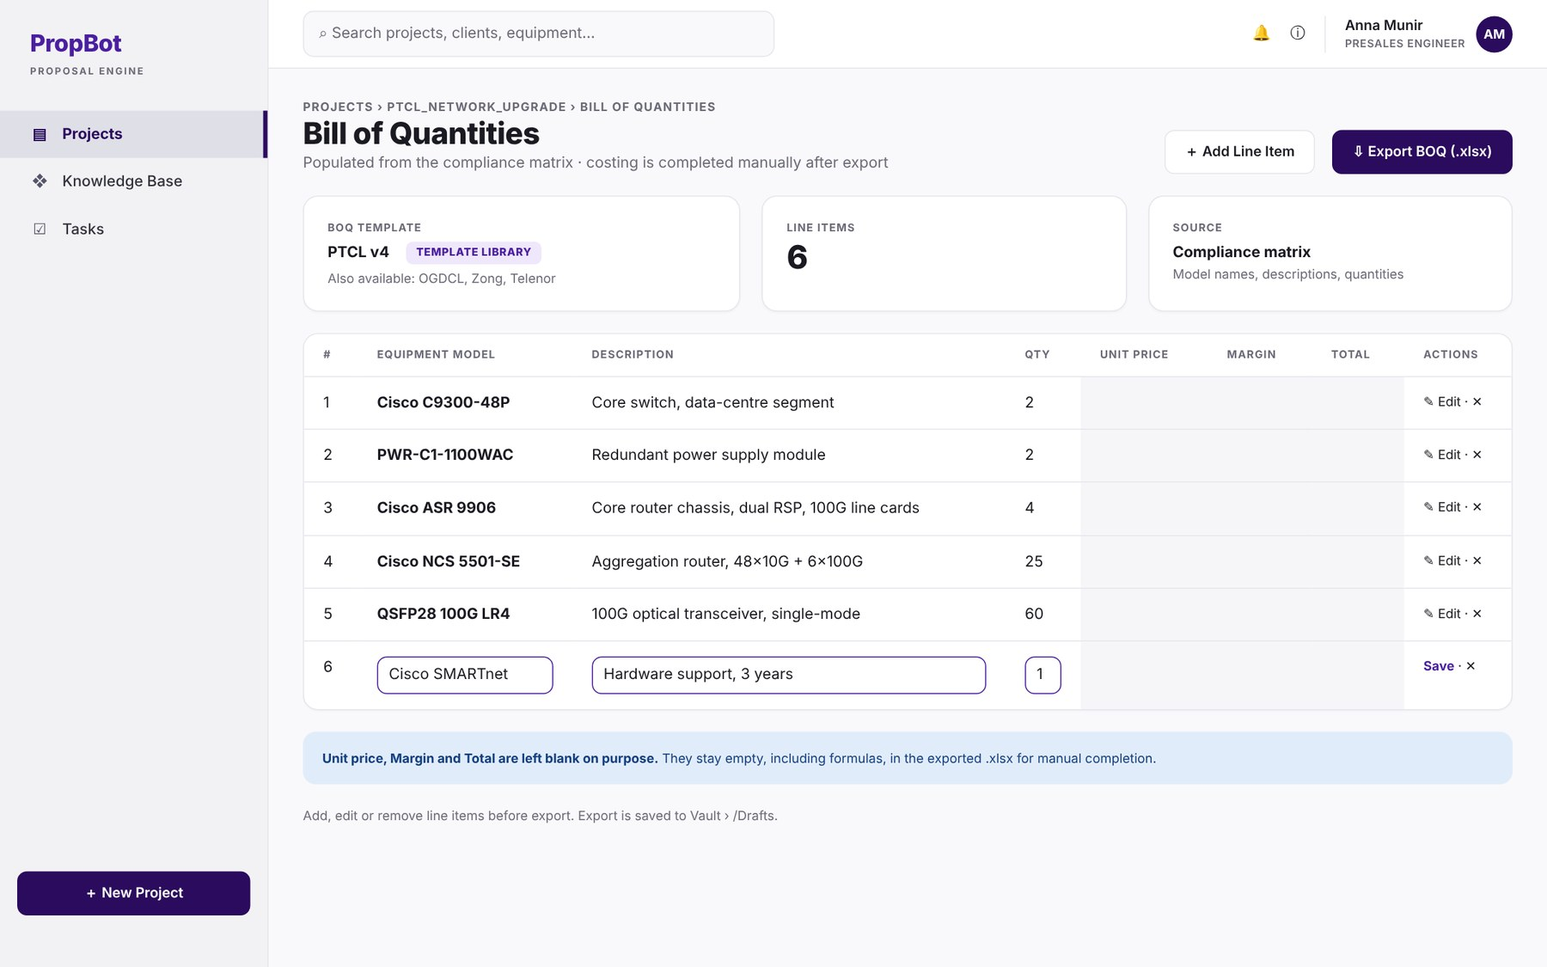
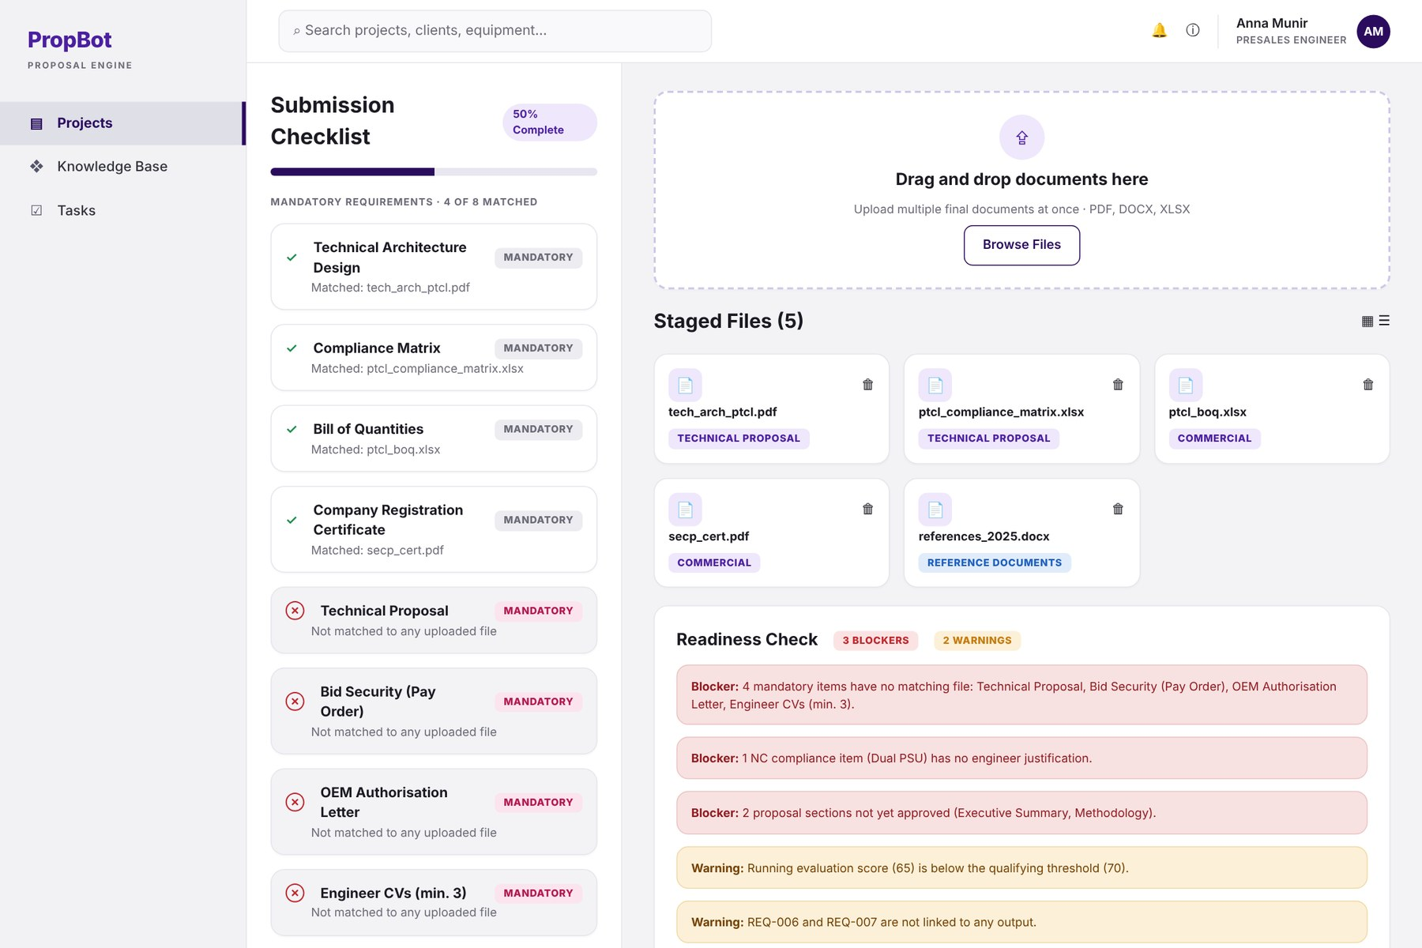
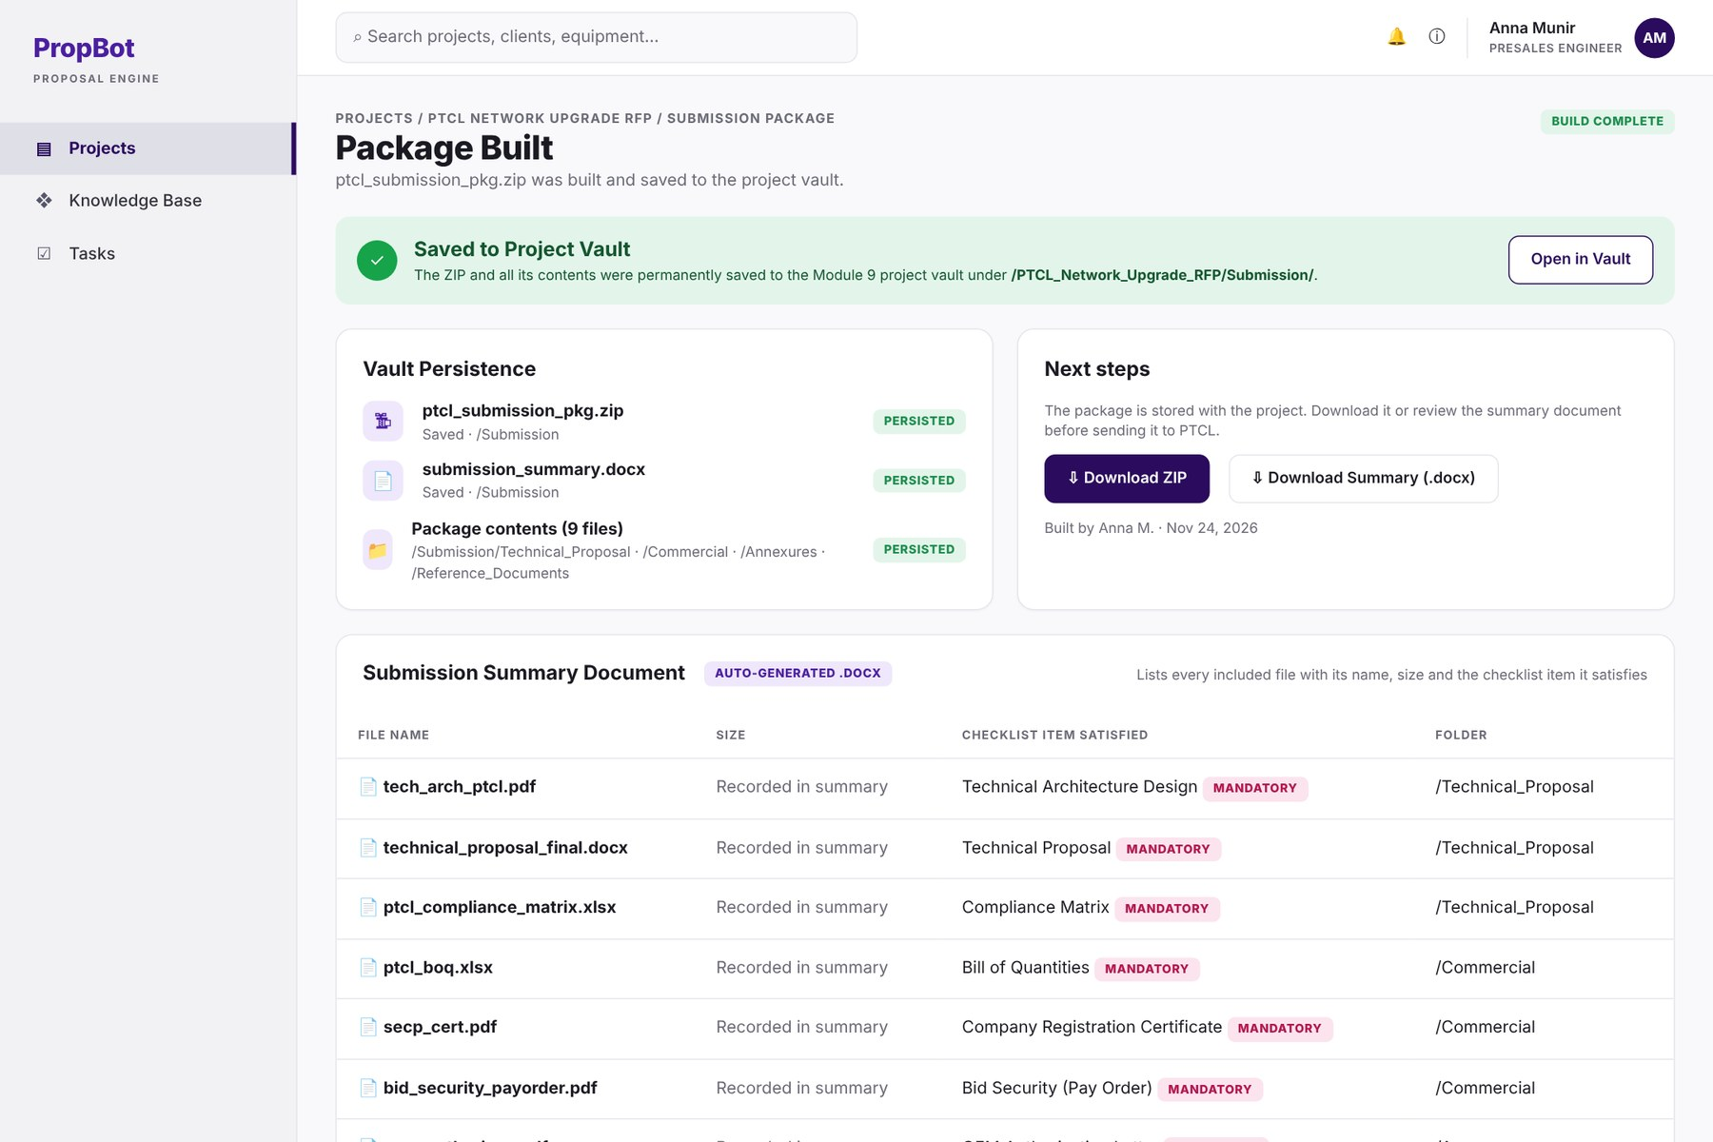
PROPOSED SOLUTION
Walkthrough: One RFP Through PropBot
STEP 1
Upload the RFP
STEP 2
Review requirement IDs
STEP 3
Collect documents
STEP 4
Check compliance
STEP 5
Track the score
W-06
W-09
W-11 · M-07
W-14
W-16
STEP 6
Generate and edit proposal
STEP 7
Reviewer approves
STEP 8
BOQ and HLD
STEP 9
Readiness check
STEP 10
Package saved, traced
W-19 · W-20
W-20 · M-03
W-23 · W-18
W-28
W-29 · W-27
PropBot · SRS Presentation 7
← Back
Contents
Next →

Slide 8
PROPOSED SOLUTION
Expected Benefits and Evaluation Targets
BENEFIT | MEASURABLE TARGET | REF.
Faster bid preparation | RFP response in under 8 hours, down from 3–7 days | BO-1
Fast reading of the RFP | Sections shown in 60 s; full extraction in 180 s (100-page text RFP) | BO-2, PER-1
Fewer missing documents | Checklist recall ≥ 0.90 and precision ≥ 0.80 | BO-3, QUA-2
Reliable compliance ratings | At least 90% of rule-based ratings match the answer key | QUA-3
Grounded proposal drafts | Mean RAGAS faithfulness > 0.85 on a fixed evaluation set | BO-5, QUA-4
No unapproved output | 0 proposals exported or packages built with an unapproved section | BO-9, BO-11
Knowledge retained | Vault search in 3 s for up to 500 projects | BO-8, PER-5
PropBot · SRS Presentation 8
← Back
Contents
Next →

Slide 9
EVALUATION FEEDBACK
Scope evaluation history
Evaluator Concerns and How We Addressed Them
Main concern on the previous scope: not enough technical depth for a three-member, one-year FYP
EVALUATOR CONCERN | WHAT WE DID | SEE
Most functions are document processing plus LLM calls; the contribution is not clear. | Moved every decision out of the LLM. Only 10 of 118 FRs call OpenAI; the other 108 are our own logic: rule engine, requirement registry, traceability, readiness gate, roles and audit. | Contribution Depth
Upload an RFP and ask an LLM to extract or generate: existing APIs can do this. | Compliance is decided by our constraint rule engine (parameter, operator, value, unit) with unit conversion and a 10% PC tolerance. Descriptive rows use our retrieval and reranking, keep the evidence and flag weak matches. | Depth W-14
Add original work: domain evaluation, structured reasoning, automated validation. | Requirement registry with IDs traced to checklist, compliance, proposal and BOQ (BO-10). Readiness gate that blocks packaging on the server (BO-11). Our own labelled benchmark of ≥ 20 RFPs from ≥ 3 clients (BO-14). | W-27 W-28
Go beyond API integration and size the work for three members. | Added Module 17 (Bid Tasks and Deadlines) and Module 18 (Android app). Final scope: 18 modules, 118 FRs, 61 screens, web and mobile on one backend, in three full work streams. | Workload Modules
PropBot · SRS Presentation 9
← Back
Contents
Next →

Slide 10
EVALUATION FEEDBACK
What Changed from the Previous Scope
AREA | PREVIOUS SCOPE | REVISED SCOPE AND SRS
Compliance logic | TF-IDF cosine similarity with fixed cut-offs (≥ 0.85 FC, ≥ 0.50 PC) | Constraint rule engine with unit conversion; evidence retrieval and reranking for descriptive rows
Datasheets | Pulled from OEM public APIs | Internal spec database or uploaded datasheet, confirmed by the engineer
Modules | 16 | 18 (added Bid Tasks and Deadlines, and the Mobile App)
Business objectives | 9 | 14 (added traceability, readiness check, benchmarks and more targets)
Validation | None | Readiness check that blocks packaging; requirement traceability; coverage check
Quality measurement | RAGAS only | Labelled benchmark set and four quality targets (QUA-1 to QUA-4)
Example: “10 Gbps required” vs “1 Gbps offered” looks similar to TF-IDF; the rule engine compares the actual values and rates it NC.
PropBot · SRS Presentation 10
← Back
Contents
Next →

Slide 11
EVALUATION FEEDBACK
Our Contribution
Proposal tools and AI assistants each cover part of the work. PropBot combines the following in one governed workflow for telecom bids:
1 Structured compliance reasoning
2 Traceability and a readiness gate
3 Governed and measured AI
Requirements become constraints (parameter, operator, value, unit) checked by rules with unit conversion. Descriptive requirements are matched to datasheet evidence through retrieval and reranking. Every rating keeps its reason and evidence.
Every requirement gets an ID linked to its checklist item, compliance row, proposal section and BOQ line. A readiness check lists blockers and stops the package until they are cleared.
RAG drafts from the company’s own approved proposals; every section needs human approval and nobody can approve their own work. Quality is measured on our own labelled benchmarks.
Positioning: Jasper AI, Proposify, Microsoft Copilot and ChatGPT do not provide FC/PC/NC compliance with evidence, requirement traceability and a readiness gate together.
PropBot · SRS Presentation 11
← Back
Contents
Next →

Slide 12
EVALUATION FEEDBACK
Technical Depth: What We Build Ourselves
Constraint rule engine
M3
Evidence retrieval and reranking
M3, M6
Local NLP pipeline
M1, M2
Each requirement becomes a constraint (parameter, operator, value, unit). Units are converted, then FC / PC / NC is decided by rules with a 10% PC tolerance, scored per model for up to 3 models.
Descriptive requirements are matched to datasheet passages by embedding search plus a MiniLM cross-encoder reranker. The top passage is stored as evidence; a weak match (< 0.5) is flagged “needs review”.
Zero-shot section classification (bart-large-mnli), spaCy entity extraction, client-format, scope and closing-date detection, all on our own server.
Requirement registry and traceability
M1, M9
Readiness gate and governance
M10, M13, M15
Grounded generation, measured
M5, M6, BO-14
Every requirement gets an ID linked to its checklist item, compliance row, proposal section and BOQ line. A coverage check lists every requirement that nothing answers.
Blockers computed on the server stop the ZIP. No self-approval, even if the UI is bypassed. Insert-only audit log enforced by the database. Data isolated per company.
RAG over the company’s approved proposals; HLD built from a device graph (Mermaid + Playwright). Quality is tested on our labelled benchmark (≥ 20 RFPs, ≥ 3 clients).
Only 10 of 118 FRs call the OpenAI API (5 generation, 5 embedding).
PropBot · SRS Presentation 12
← Back
Contents
Next →

Slide 13
MODULES ·
18 modules · 118 FRs
Modules and Main FRs (1 of 5)
M1 RFP Parser and Classifier
M2 Submission Checklist Generator
Reads a PDF or Word RFP, sorts sections into 5 types and extracts equipment, scope, client format and closing date into a requirement registry.
Lists every document the RFP asks for, marks it mandatory or optional, tracks collection and blocks submission while a mandatory item is missing.
MAIN FUNCTIONAL REQUIREMENTS
MAIN FUNCTIONAL REQUIREMENTS
FR-1.1 RFP File Upload
FR-1.3 Section Classification
FR-2.1 Checklist Item Extraction
FR-2.2 Mandatory or Optional
FR-1.4 Entity Extraction
FR-1.10 Requirement Registry
FR-2.4 Checklist Tick-Off
FR-2.6 Submission Blocking
Screens W-06–W-10
Proposal workflow · 11 FRs
Screens W-11, W-12
Proposal workflow · 7 FRs
M3 Compliance Matrix Generator
M4 Technical Evaluation Criteria Analyser
Rates every requirement FC, PC or NC with a constraint rule engine and evidence retrieval, and scores up to three proposed models.
Reads the RFP’s scoring table and shows a live running score against the qualifying threshold.
MAIN FUNCTIONAL REQUIREMENTS
MAIN FUNCTIONAL REQUIREMENTS
FR-3.3 Rule-Based Evaluation
FR-3.4 Compliance Percentage
FR-4.1 Scoring Table Extraction
FR-4.3 Threshold Display
FR-3.9 Descriptive Matching
FR-3.6 Manual Override
FR-4.4 Running Score
FR-4.5 Below-Threshold Warning
Screens W-13–W-15
Proposal workflow · 10 FRs
Screens W-16, W-46
Proposal workflow · 6 FRs
PropBot · SRS Presentation 14
← Back
Contents
Next →

Slide 14
MODULES ·
18 modules · 118 FRs
Modules and Main FRs (2 of 5)
M5 HLD Diagram Generator
M6 Technical Proposal Generator
Draws the high-level network diagram from the device list with standard icons and writes its connectivity description.
Drafts the four proposal sections from the company’s approved past proposals (RAG); every section is reviewed, approved and linked to requirements.
MAIN FUNCTIONAL REQUIREMENTS
MAIN FUNCTIONAL REQUIREMENTS
FR-5.1 Network Device Input
FR-5.3 Topology Rendering
FR-6.3 Semantic Retrieval
FR-6.5 Section Generation
FR-5.5 PNG Export
FR-5.7 Connectivity Description
FR-6.8 Reviewer Approval Gate
FR-6.11 Requirement Linking
Screens W-17, W-18
Proposal workflow · 7 FRs
Screens W-19–W-21
Proposal workflow · 12 FRs
M7 BOQ Generator
M8 Responsibility Matrix Generator
Fills the client’s BOQ template from the compliance matrix; costing columns are left for manual entry.
Builds the 24-row responsibility matrix from a standard template with rule-based assignment.
MAIN FUNCTIONAL REQUIREMENTS
MAIN FUNCTIONAL REQUIREMENTS
FR-7.1 BOQ Template Library
FR-7.2 Auto-Population
FR-8.1 Standard Template
FR-8.2 Auto-Assignment
FR-7.3 Costing Left Blank
FR-7.5 BOQ Export
FR-8.3 Row Editing
FR-8.4 Matrix Export
Screens W-23, W-39
Proposal workflow · 5 FRs
Screens W-24, W-40
Proposal workflow · 5 FRs
PropBot · SRS Presentation 15
← Back
Contents
Next →

Slide 15
MODULES ·
18 modules · 118 FRs
Modules and Main FRs (3 of 5)
M9 Project Vault and Centralised Storage
M10 Submission Package Builder
Keeps every project in its own folder on the company server: searchable, with status and a traceability view.
Matches the final files to the checklist, runs the readiness check and builds the ZIP submission package.
MAIN FUNCTIONAL REQUIREMENTS
MAIN FUNCTIONAL REQUIREMENTS
FR-9.1 Per-Project Folders
FR-9.3 Full-Text Search
FR-10.2 Checklist Cross-Check
FR-10.7 Readiness Check
FR-9.6 Project Status
FR-9.7 Traceability View
FR-10.4 ZIP Generation
FR-10.6 Submission Summary
Screens W-05, W-25–W-27, W-47
Proposal workflow · 7 FRs
Screens W-28, W-29
Proposal workflow · 7 FRs
M11 Knowledge Base and Past Project Reuse
M12 Company and Organisation Management
Stores approved proposals with metadata so the next bid can reuse the company’s best past content.
Creates company workspaces on the platform and keeps each company’s data fully separate.
MAIN FUNCTIONAL REQUIREMENTS
MAIN FUNCTIONAL REQUIREMENTS
FR-11.1 Automatic Ingestion
FR-11.2 Metadata Tagging
FR-12.1 Workspace Creation
FR-12.2 Data Isolation
FR-11.3 Win/Loss Boost
FR-11.6 Coverage Dashboard
FR-12.3 Organisation Listing
Screens W-30–W-33
Proposal workflow · 6 FRs
Screens W-34, W-35
Administration · 3 FRs
PropBot · SRS Presentation 16
← Back
Contents
Next →

Slide 16
MODULES ·
18 modules · 118 FRs
Modules and Main FRs (4 of 5)
M13 User and Role Management
M14 Template Library Management
Five fixed roles, email invitations, secure sessions and the rule that nobody approves their own work.
Keeps versioned BOQ and responsibility templates up to date for every client.
MAIN FUNCTIONAL REQUIREMENTS
MAIN FUNCTIONAL REQUIREMENTS
FR-13.1 Role-Based Access
FR-13.2 User Invitation
FR-14.1 BOQ Template Upload
FR-14.2 Responsibility Template
FR-13.3 Self-Approval Prevention
FR-13.4 Session Tokens
FR-14.3 Version Pinning
Screens W-01–W-04, W-20, W-22, W-36–W-38, W-47, M-01, M-05
Administration · 6 FRs
Screens W-39, W-40
Administration · 3 FRs
M15 Audit Log and Activity Tracking
M16 Analytics Dashboard
Records every important action in an insert-only log that can be filtered and exported.
Shows turnaround time, client mix and the most common non-compliant items.
MAIN FUNCTIONAL REQUIREMENTS
MAIN FUNCTIONAL REQUIREMENTS
FR-15.1 Audit Record
FR-15.3 Audit Log Filtering
FR-16.1 Summary Metrics
FR-16.2 Turnaround Chart
FR-15.4 Insert-Only Records
FR-15.6 Project Timeline
FR-16.3 Client Breakdown
FR-16.4 Top NC Items
Screens W-41, W-42
Administration · 6 FRs
Screens W-43
Administration · 4 FRs
PropBot · SRS Presentation 17
← Back
Contents
Next →

Slide 17
MODULES ·
18 modules · 118 FRs
Modules and Main FRs (5 of 5)
M17 Bid Tasks and Deadlines
M18 Mobile Application
Creates bid tasks from the closing date, assigns them to engineers and sends deadline alerts.
Android-first app for approvals, camera document capture, tasks and push alerts.
MAIN FUNCTIONAL REQUIREMENTS
MAIN FUNCTIONAL REQUIREMENTS
FR-17.1 Automatic Task Creation
FR-17.2 Manual Task Assignment
FR-18.3 Mobile Proposal Review
FR-18.4 Document Capture
FR-17.3 Task Views
FR-17.4 Deadline Alerts
FR-18.5 Mobile Tasks View
FR-18.6 Push Notifications
Screens W-05, W-44–W-46, M-09
Proposal workflow · 5 FRs
Screens M-01–M-14
Mobile · 8 FRs
ALL 18 MODULES AT A GLANCE
M1 RFP Parser and Classifier
M2 Submission Checklist Generator
M3 Compliance Matrix Generator
M4 Technical Evaluation Criteria Analyser
M5 HLD Diagram Generator
M6 Technical Proposal Generator
M7 BOQ Generator
M8 Responsibility Matrix Generator
M9 Project Vault and Centralised Storage
M10 Submission Package Builder
M11 Knowledge Base and Past Project Reuse
M12 Company and Organisation Management
M13 User and Role Management
M14 Template Library Management
M15 Audit Log and Activity Tracking
M16 Analytics Dashboard
M17 Bid Tasks and Deadlines
M18 Mobile Application
PropBot · SRS Presentation 18
← Back
Contents
Next →

Slide 18
REQUIREMENTS
Requirement Elicitation Process
Document analysis
Discussions with presales engineers
What: the approved scope, the scope evaluation remarks and sample telecom RFP documents.
Why: the remarks defined what had to change; real RFPs show the structure the system must read.
What: how bids are prepared today in telecom IT companies.
Why: to understand the manual workflow, its steps and its pain points.
Related system analysis
Prototyping
What: Jasper AI, Proposify, Microsoft Copilot and ChatGPT.
Why: to learn what existing tools cover and position PropBot against them.
What: 61 mockups (47 web, 14 mobile), reviewed by the team.
Why: makes each user action and system response explicit, so FRs can be derived from them.
Result: 18 modules → 118 features → 41 use cases → 118 functional requirements and 40 non-functional requirements
PropBot · SRS Presentation 19
← Back
Contents
Next →

Slide 19
REQUIREMENTS
Requirement Analysis Techniques
Mockups
Event–Response Tables
Walkthrough
User actions and system responses
How the back end reacts to events
One bid through the screens
61 screens (W-01–W-47, M-01–M-14). Each screen’s actions and responses give FRs and business rules; all 118 FRs are mapped to a screen (§2.5.1, §2.5.3).
4 back-end processes with trigger, source, states, response and exceptions: sessions, audit logging, deadlines and alerts, and the readiness check (§2.5.2).
One RFP followed from upload to the saved submission package across the linked mockups.
See example →
See example →
See walkthrough →
PropBot · SRS Presentation 20
← Back
Contents
Next →

Slide 20
REQUIREMENTS · TABLE 2.56
Module 10
Event–Response Table: Submission Readiness Check
EVENT | TRIGGER | RESPONSE | STATE AFTER | EXCEPTION
Packaging attempt initiated | Engineer requests the submission package | 1. Check mandatory checklist items. 2. Check NC items for a justification. 3. Check proposal sections for approval. | Blocker and warning list computed | —
Blocker detected | Missing mandatory item, unjustified NC item or unapproved section | 1. Add the item to the blocker list. 2. Prevent ZIP generation. | Packaging blocked; blocker list shown | Engineer resolves each blocker and re-runs the check
Warning detected | Score below the qualifying threshold, or a requirement not linked to any output | 1. Add the item to the warning list. 2. Still allow packaging. | Packaging proceeds; warnings shown | —
Readiness check passed | No blockers remain | 1. Allow ZIP generation. 2. Save to the project vault. | Package built and stored | —
DERIVED REQUIREMENTS FR-10.3 blocking error list · FR-10.7 readiness check · FR-2.6 submission blocking · FR-10.4 ZIP generation · FR-10.5 vault persistence
PropBot · SRS Presentation 21
← Back
Contents
← Techniques
Mockup W-28
Next →

Slide 21
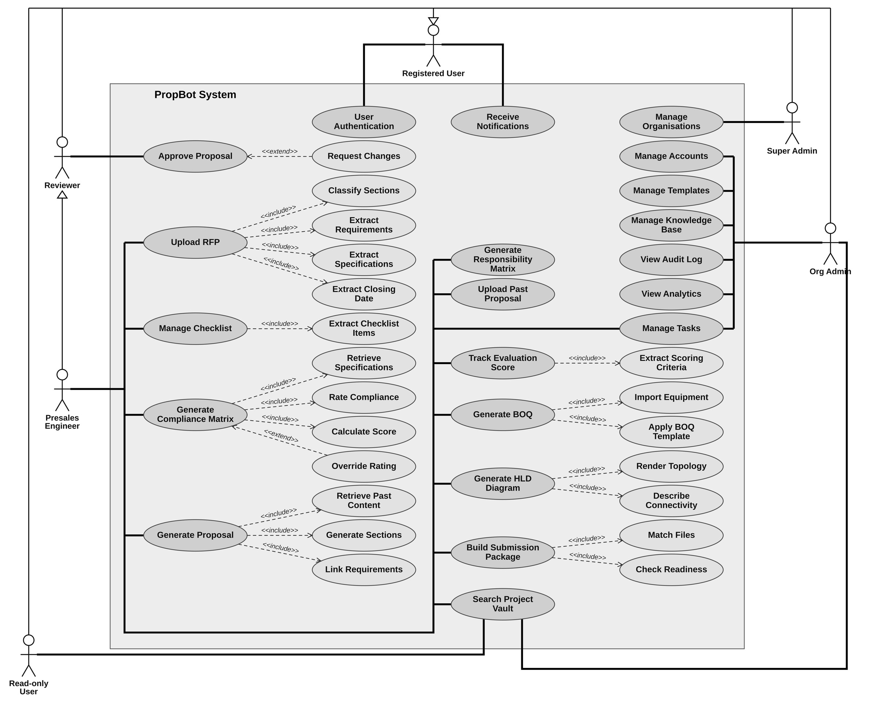
USE CASES
Use Case Diagram
Figure 2.1
6
actors
41
use cases
21 base
18 «include»
2 «extend»
← Back
Actors →
PropBot · SRS Presentation 22
Contents

Slide 22
USE CASES · FIGURE 2.1
Actors and Their Use Cases
Presales Engineer main user · 13 use cases
Org Admin company manager
Upload RFP (+4 «include»)
Manage Checklist (+1)
Track Evaluation Score (+1)
Generate Compliance Matrix (+3, +1 «extend»)
Generate Proposal (+3)
Generate BOQ (+2)
Generate HLD Diagram (+2)
Generate Responsibility Matrix
Build Submission Package (+2)
Upload Past Proposal
Search Project Vault
Manage Tasks
Approve Proposal (as a peer reviewer)
Manage Accounts
Manage Templates
Manage Knowledge Base
View Audit Log
View Analytics
Manage Tasks
Search Project Vault
Reviewer
Super Admin platform
Approve Proposal
Request Changes «extend»
Manage Organisations
Read-only User
Registered User all 5 roles
Search Project Vault
User Authentication
Receive Notifications
Generalisation: every role is a Registered User; a Presales Engineer is also a Reviewer.
PropBot · SRS Presentation 23
← Back
Contents
← Diagram
Next →

Slide 23
USE CASES BY ACTOR · FIGURE 2.1, TABLE 2.2
Actor: Presales Engineer (1 of 3)
USE CASE | TYPE | WHAT IT DOES | FUNCTIONAL REQS | SCREENS
PRESALES ENGINEER main user · prepares the whole bid
Upload RFP | Base | Upload a PDF or Word RFP and start parsing it | FR-1.1–1.2, 1.5–1.7 | W-06, W-10
↳ Classify Sections | «include» | Sort every section into 5 types; the engineer can relabel | FR-1.3, 1.8 | W-06, W-07
↳ Extract Requirements | «include» | Give each requirement an ID in the requirement registry | FR-1.10–1.11 | W-06, W-09
↳ Extract Specifications | «include» | Pull out equipment, quantities and specification values | FR-1.4 | W-06
↳ Extract Closing Date | «include» | Find the bid deadline, or ask the engineer to enter it | FR-1.9 | W-06, W-08
Manage Checklist | Base | Tick documents as collected and attach their files | FR-2.4–2.7, 18.4 | W-11, W-12, M-06–M-08
↳ Extract Checklist Items | «include» | List every required document as mandatory or optional | FR-2.1–2.3 | W-11
Track Evaluation Score | Base | Show marks, thresholds and the live running score | FR-4.2–4.4, 4.6 | W-16
↳ Extract Scoring Criteria | «include» | Read the scoring table from the RFP | FR-4.1 | W-16
Upload Past Proposal | Base | Add an old proposal to the knowledge base | FR-11.4 | W-31
PropBot · SRS Presentation 24
← Back
Contents
Actors
Diagram
Next →

Slide 24
USE CASES BY ACTOR · FIGURE 2.1, TABLE 2.2
Actor: Presales Engineer (2 of 3)
USE CASE | TYPE | WHAT IT DOES | FUNCTIONAL REQS | SCREENS
PRESALES ENGINEER compliance, proposal and tasks
Generate Compliance Matrix | Base | Enter the proposed models and get the FC / PC / NC matrix | FR-3.1, 3.5, 3.7–3.8 | W-14
↳ Retrieve Specifications | «include» | Get each model’s specifications, confirmed by the engineer | FR-3.2 | W-13
↳ Rate Compliance | «include» | Rule engine and evidence matching rate each requirement | FR-3.3, 3.9–3.10 | W-14
↳ Calculate Score | «include» | Work out the compliance percentage for each model | FR-3.4 | W-14
↳ Override Rating | «extend» | Only when the engineer disagrees: change a rating with a reason (optional) | FR-3.6 | W-14, W-15
Generate Proposal | Base | Create, edit and export the technical proposal | FR-6.6–6.7, 6.9–6.10 | W-19, W-20, W-21
↳ Retrieve Past Content | «include» | Find the most relevant approved past content (RAG) | FR-6.1–6.4, 11.3 | W-19, W-32
↳ Generate Sections | «include» | Write the four proposal sections with GPT-4o-mini | FR-6.5 | W-19
↳ Link Requirements | «include» | Link sections to requirement IDs and list uncovered ones | FR-6.11–6.12 | W-20
Manage Tasks | Base | Tasks created from the closing date; assign and track them | FR-17.1–17.3, 17.5, 18.5 | W-05, W-44, W-45, M-09, M-10
PropBot · SRS Presentation 25
← Back
Contents
Actors
Diagram
Next →

Slide 25
USE CASES BY ACTOR · FIGURE 2.1, TABLE 2.2
Actor: Presales Engineer (3 of 3)
USE CASE | TYPE | WHAT IT DOES | FUNCTIONAL REQS | SCREENS
PRESALES ENGINEER bid deliverables and package
Generate BOQ | Base | Edit and export the client’s Bill of Quantities | FR-7.3–7.5 | W-23
↳ Import Equipment | «include» | Bring the proposed models in from the compliance matrix | FR-7.2 | W-23
↳ Apply BOQ Template | «include» | Use the right client template (PTCL, Zong and others) | FR-7.1 | W-23, W-39
Generate HLD Diagram | Base | Enter the network devices and export the diagram | FR-5.1–5.2, 5.5–5.6 | W-17, W-18
↳ Render Topology | «include» | Draw the network diagram with standard icons | FR-5.3–5.4 | W-18
↳ Describe Connectivity | «include» | Write a short description of how the network connects | FR-5.7 | W-18
Generate Responsibility Matrix | Base | Assign who is responsible for each task, then export | FR-8.1–8.4 | W-24
Build Submission Package | Base | Upload the final files and build the ZIP package | FR-10.1, 10.4–10.6 | W-28, W-29
↳ Match Files | «include» | Match each uploaded file to its checklist item | FR-10.2 | W-28
↳ Check Readiness | «include» | List blockers and warnings; no ZIP while a blocker is open | FR-10.3, 10.7 | W-28
Search Project Vault | Base | Search, browse and trace past projects | FR-9.1–9.7, 18.7 | W-05, W-25, W-26, W-27, W-47, M-13
PropBot · SRS Presentation 26
← Back
Contents
Actors
Diagram
Next →

Slide 26
USE CASES BY ACTOR · FIGURE 2.1, TABLE 2.2
Actors: Reviewer and Registered User
USE CASE | TYPE | WHAT IT DOES | FUNCTIONAL REQS | SCREENS
REVIEWER a Presales Engineer can also review another engineer’s section
Approve Proposal | Base | Approve each section; nobody can approve their own | FR-6.8, 13.3, 18.3, 18.8 | W-20, W-22, M-02, M-03, M-05, M-14
↳ Request Changes | «extend» | Only when a section needs revision: send it back with a comment (optional) | FR-6.8, 18.3 | W-20, M-04
REGISTERED USER every one of the five roles
User Authentication | Base | Log in, keep a secure session and reset a password, on web and mobile | FR-13.1, 13.4, 13.6, 18.1–18.2 | W-01–W-04, M-01, M-02
Receive Notifications | Base | Get deadline, approval, NC and low-score alerts | FR-4.5, 17.4, 18.6 | W-16, W-46, M-11, M-12
PropBot · SRS Presentation 27
← Back
Contents
Actors
Diagram
Next →

Slide 27
USE CASES BY ACTOR · FIGURE 2.1, TABLE 2.2
Actors: Org Admin, Super Admin and Read-only User
USE CASE | TYPE | WHAT IT DOES | FUNCTIONAL REQS | SCREENS
ORG ADMIN manages one company
Manage Accounts | Base | Invite users, give them a role and deactivate accounts | FR-13.1–13.2, 13.5 | W-04, W-36, W-37, W-38
Manage Templates | Base | Keep BOQ and responsibility templates up to date | FR-8.5, 14.1–14.3 | W-39, W-40
Manage Knowledge Base | Base | Re-tag or delete documents and check coverage | FR-11.1–11.2, 11.5–11.6 | W-30, W-32, W-33
View Audit Log | Base | Filter and export the record of every important action | FR-15.1–15.6 | W-41, W-42
View Analytics | Base | See turnaround time, client mix and top NC items | FR-16.1–16.4 | W-43
Manage Tasks | Shared | Tasks created from the closing date; assign and track them | FR-17.1–17.3, 17.5, 18.5 | W-05, W-44, W-45, M-09, M-10
Search Project Vault | Shared | Search, browse and trace past projects | FR-9.1–9.7, 18.7 | W-05, W-25, W-26, W-27, W-47, M-13
SUPER ADMIN runs the platform
Manage Organisations | Base | Create company workspaces on the platform | FR-12.1–12.3 | W-34, W-35
READ-ONLY USER views past work
Search Project Vault | Shared | Search, browse and trace past projects | FR-9.1–9.7, 18.7 | W-05, W-25, W-26, W-27, W-47, M-13
PropBot · SRS Presentation 28
← Back
Contents
Actors
Diagram
Next →

Slide 28
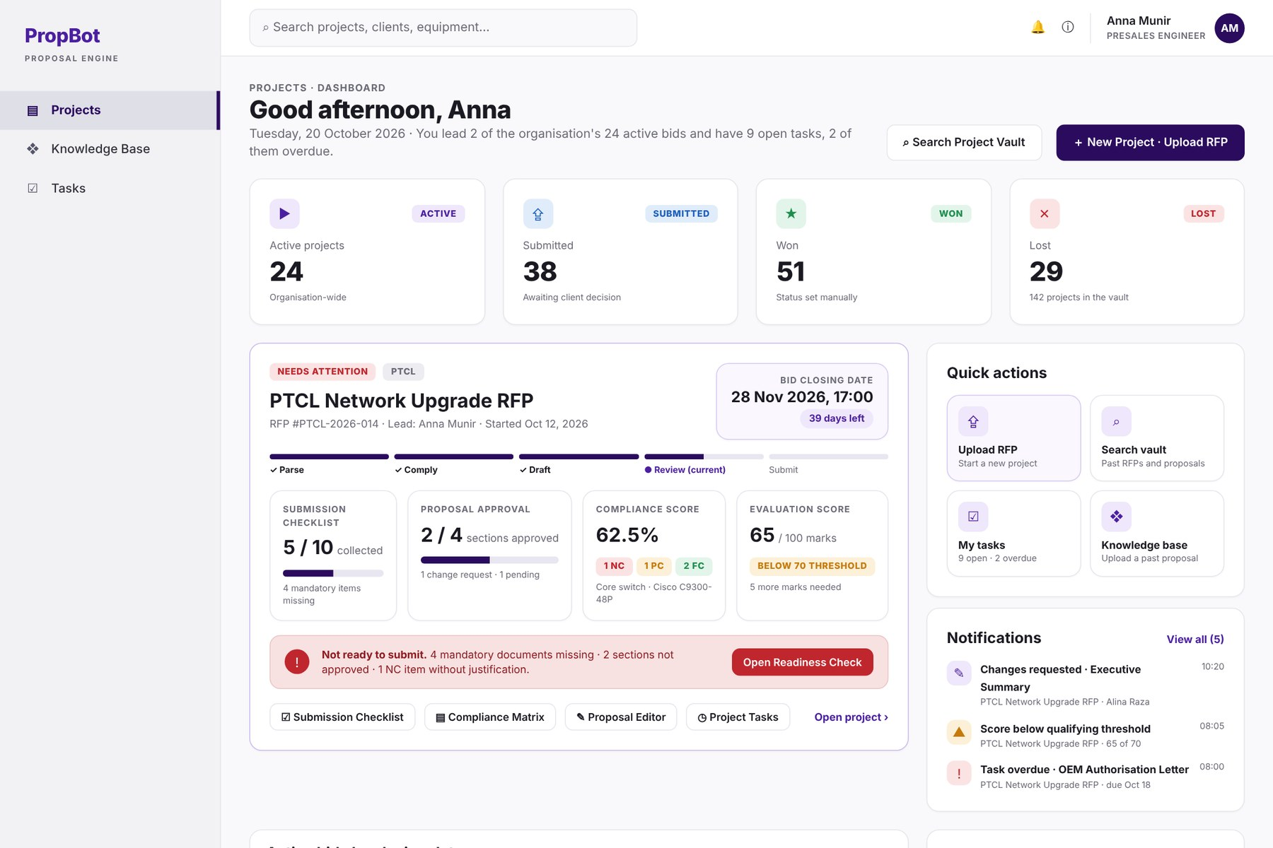
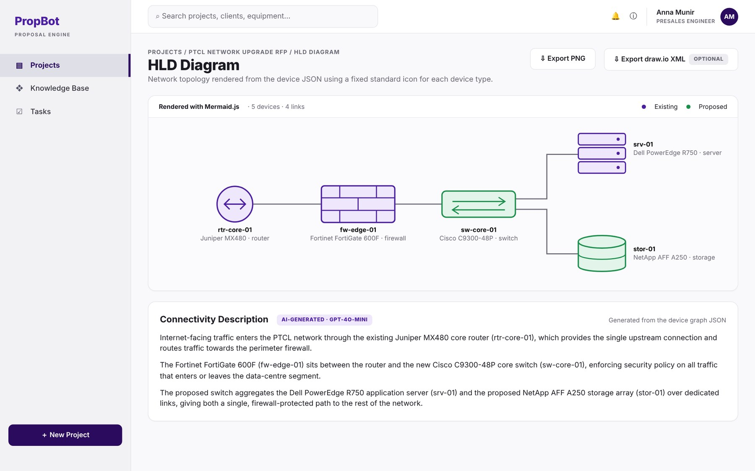
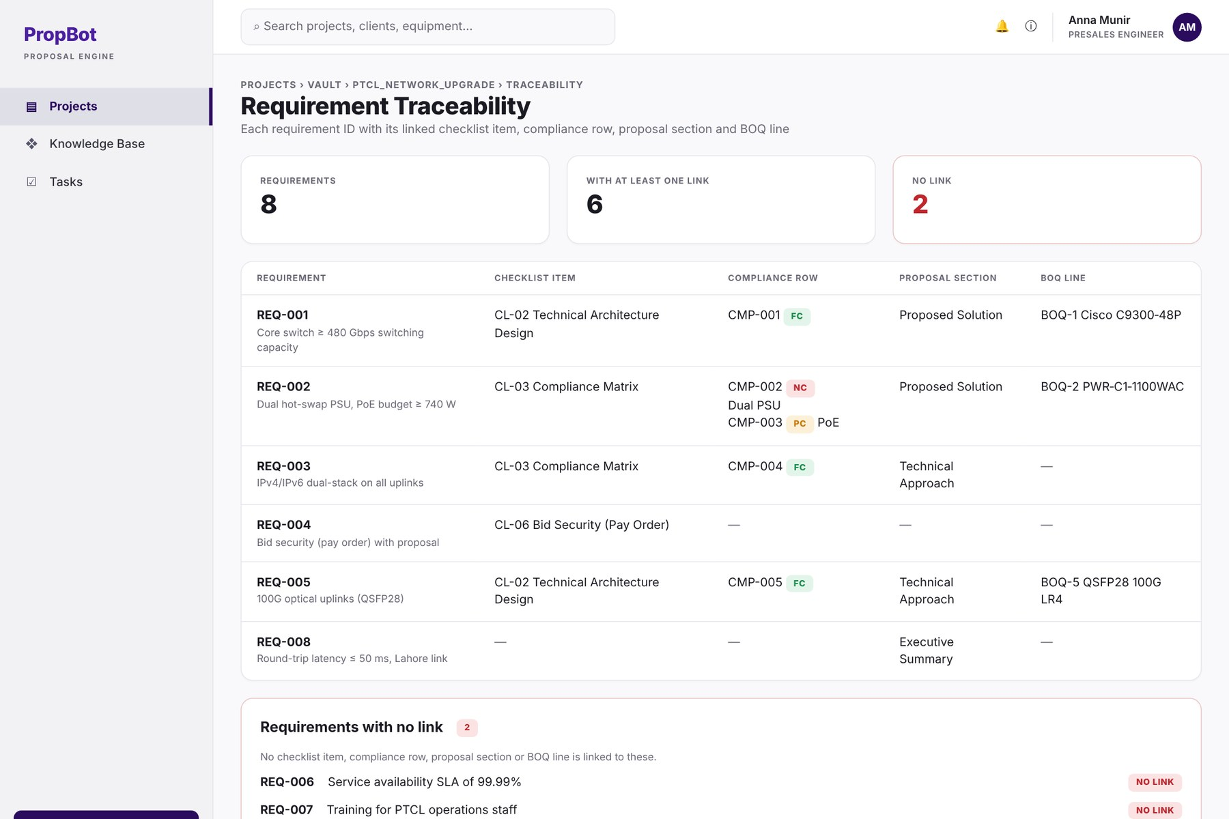
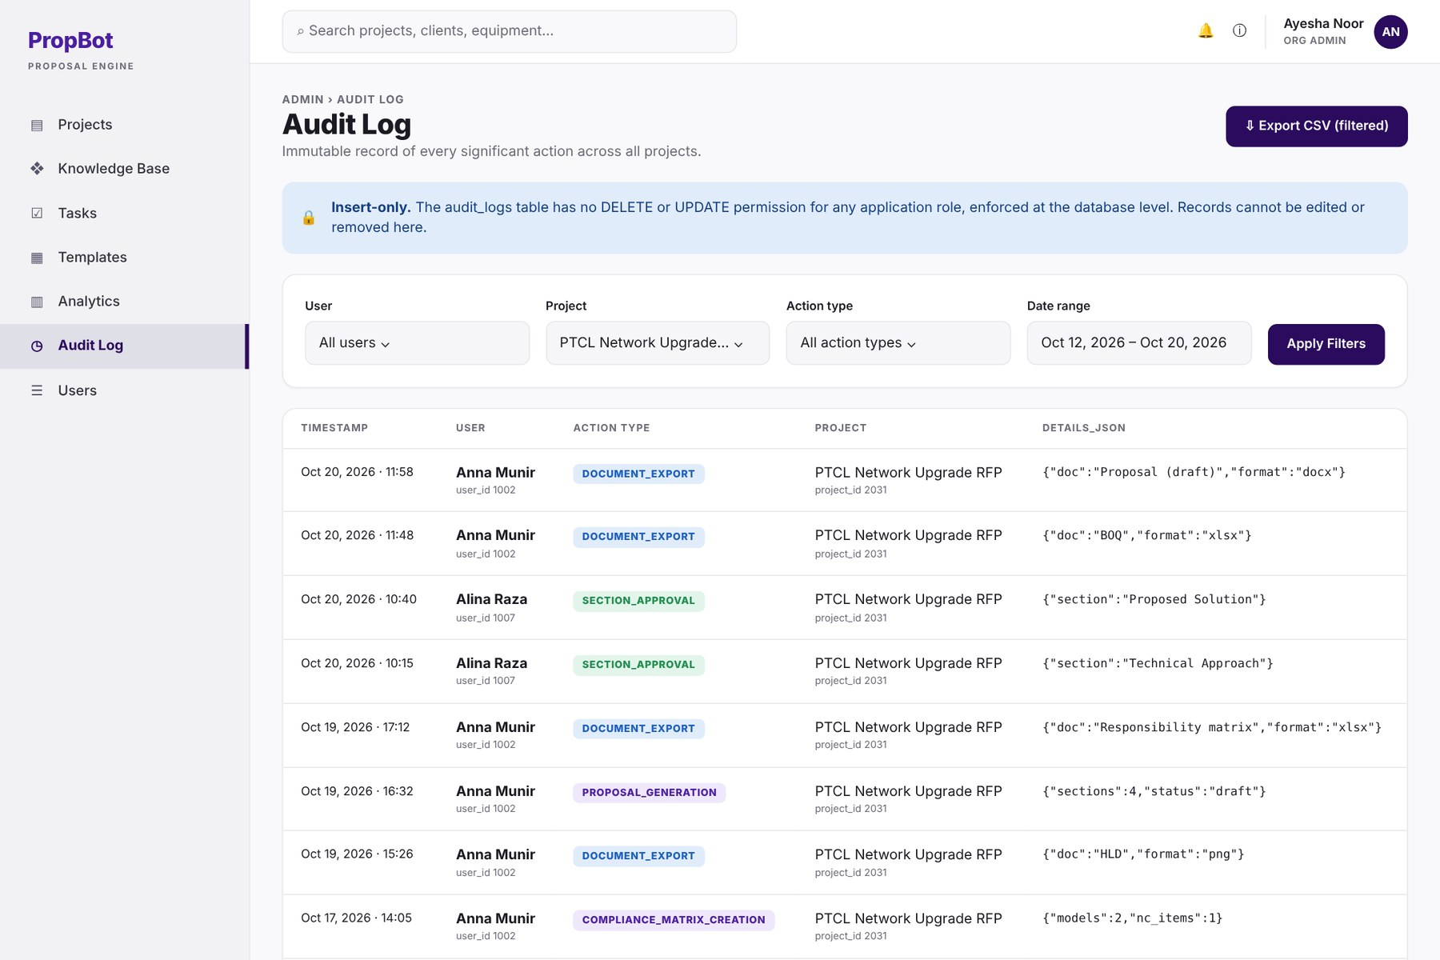
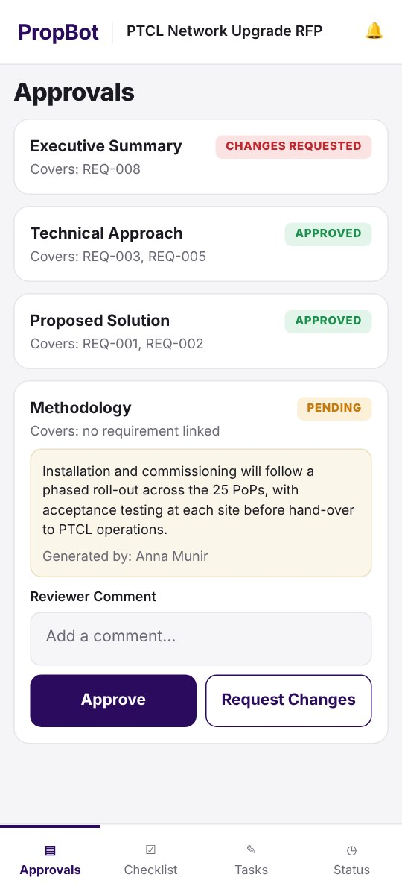
MOCKUPS ·
13 of 61 screens
Key Mockups
W-05 Projects Dashboard
W-06 RFP Upload & Parsing
W-09 Requirement Registry
W-11 Submission Checklist
W-14 Compliance Matrix
W-16 Technical Evaluation Criteria Analyser
W-18 HLD Diagram & Connectivity Description
W-20 Proposal Review Editor
W-23 BOQ Editor
W-27 Requirement Traceability View
W-28 Submission Package Builder
W-41 Audit Log
M-03 · M-07 Mobile approvals and capture
PropBot · SRS Presentation 29
← Back
Contents
Next →

Slide 29
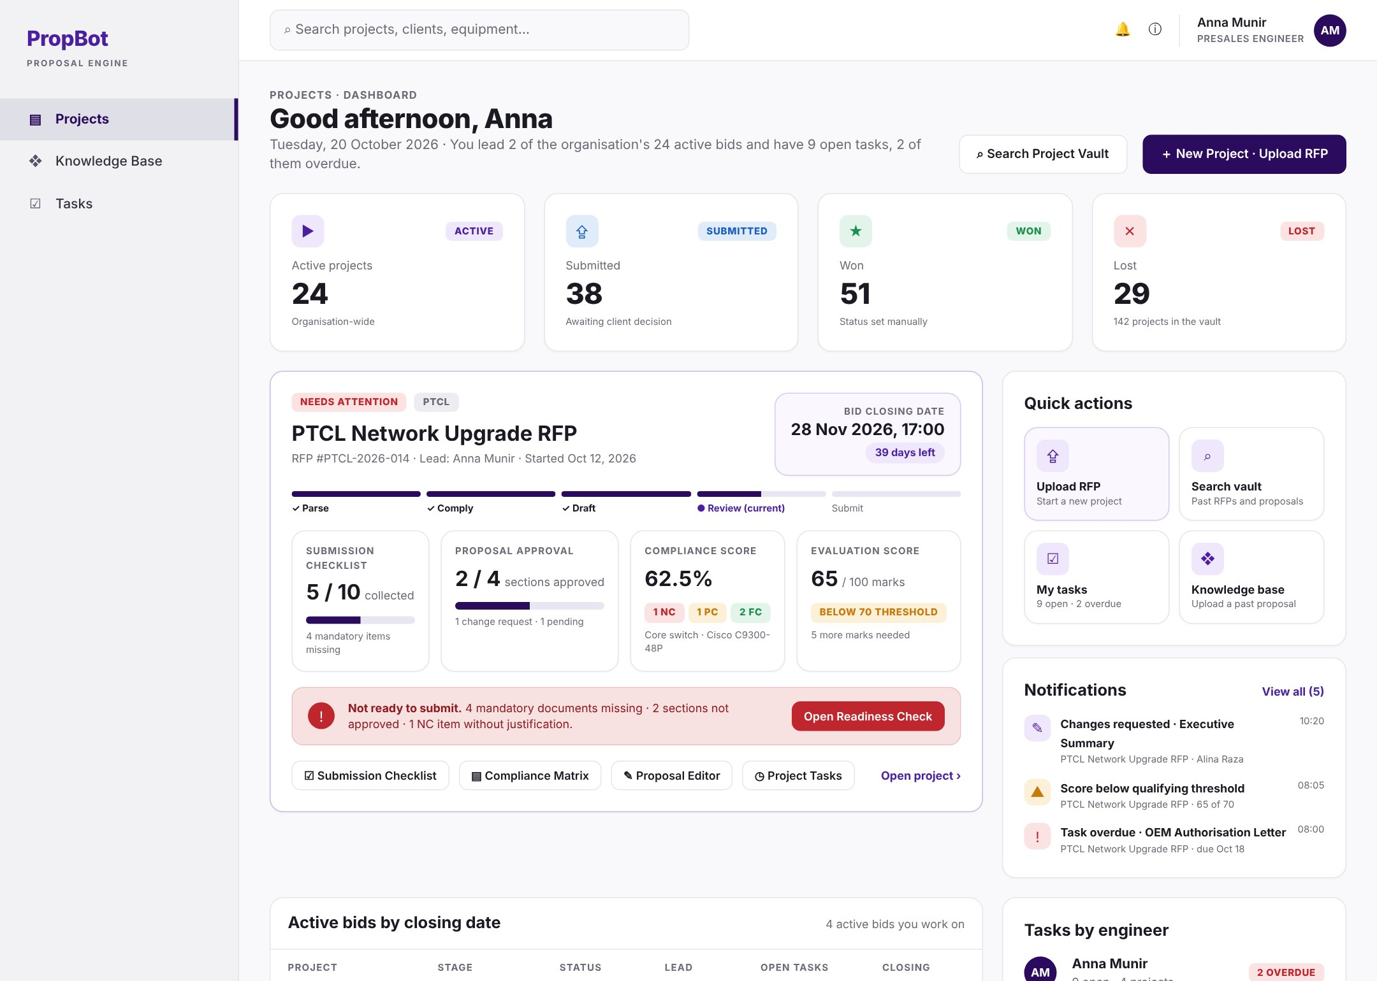
W-05 – Projects Dashboard
The engineer’s home screen: bid status cards, the bid that needs attention, tasks and alerts.
FUNCTIONAL REQUIREMENT
BUSINESS RULE
1
FR-9.6 · Project Status
Active, submitted, won or lost
Only four values: active, submitted, won, lost. Set by the engineer.
1
2
FR-17.3 · Task Views
Tasks per project and per engineer; overdue in red
Overdue tasks are highlighted in red.
2
Use case: Search Project Vault · Manage Tasks ■ rule from the SRS ■ condition stated in the FR
PropBot · SRS Presentation 30
← Back
Contents
Module
Use case
Next →

Slide 30
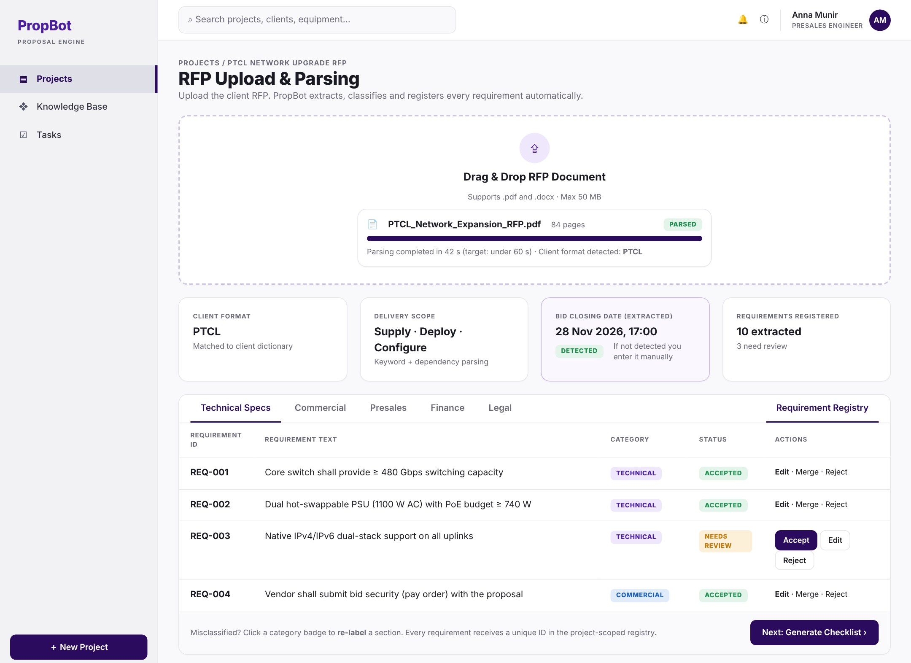
W-06 – RFP Upload & Parsing (1/2)
Upload an RFP and see it split into classified sections, with scope, client format and key facts.
FUNCTIONAL REQUIREMENT
BUSINESS RULE
1
FR-1.1 · RFP File Upload
Accepts PDF and Word RFPs up to 50 MB
Only PDF or DOCX; maximum 50 MB.
1
2
2
FR-1.2 · Raw Text Extraction
Reads the text with PyMuPDF and python-docx
PDF read with PyMuPDF, Word with python-docx.
5
FR-1.3 · Section Classification
Sorts every section into 5 types (zero-shot model)
Exactly five fixed section categories.
3
3
4
4
FR-1.4 · Entity Extraction
Pulls out equipment, quantities, protocols and specs
Applied to the technical sections of the RFP.
5
FR-1.5 · Delivery Scope Detection
Finds the scope: supply, deploy, configure, migrate
Scope is one or more of: supply, deploy, configure, migrate.
Use case: Upload RFP (+ Classify Sections, Extract Specifications) ■ rule from the SRS ■ condition stated in the FR
PropBot · SRS Presentation 31
← Back
Contents
Module
Use case
Next →

Slide 31
W-06 – RFP Upload & Parsing (2/2)
Upload an RFP and see it split into classified sections, with scope, client format and key facts.
FUNCTIONAL REQUIREMENT
BUSINESS RULE
1
FR-1.6 · Client Format Detection
Detects PTCL, OGDCL, Zong, Telenor; else generic rules
PTCL, OGDCL, Zong, Telenor only; any other client uses the generic rules.
2
FR-1.7 · Parsing Turnaround
Sections shown in 60 s; extraction done in 180 s
Sections ≤ 60 s; full extraction ≤ 180 s (95th percentile).
2
1
4
5
FR-1.8 · Manual Re-classification
Engineer can fix any wrong section label
Any section label can be changed by the engineer.
3
4
FR-1.9 · Closing Date Extraction
Finds the bid closing date; manual entry if missing
If not found automatically, the engineer must enter it manually.
3
5
FR-1.10 · Requirement Registry
Each requirement gets an ID; accept, edit, merge, reject
IDs are unique per project; the engineer decides each one: accept, edit, merge or reject.
Use case: Upload RFP (+ Classify Sections, Extract Specifications) ■ rule from the SRS ■ condition stated in the FR
PropBot · SRS Presentation 32
← Back
Contents
Module
Use case
Next →

Slide 32
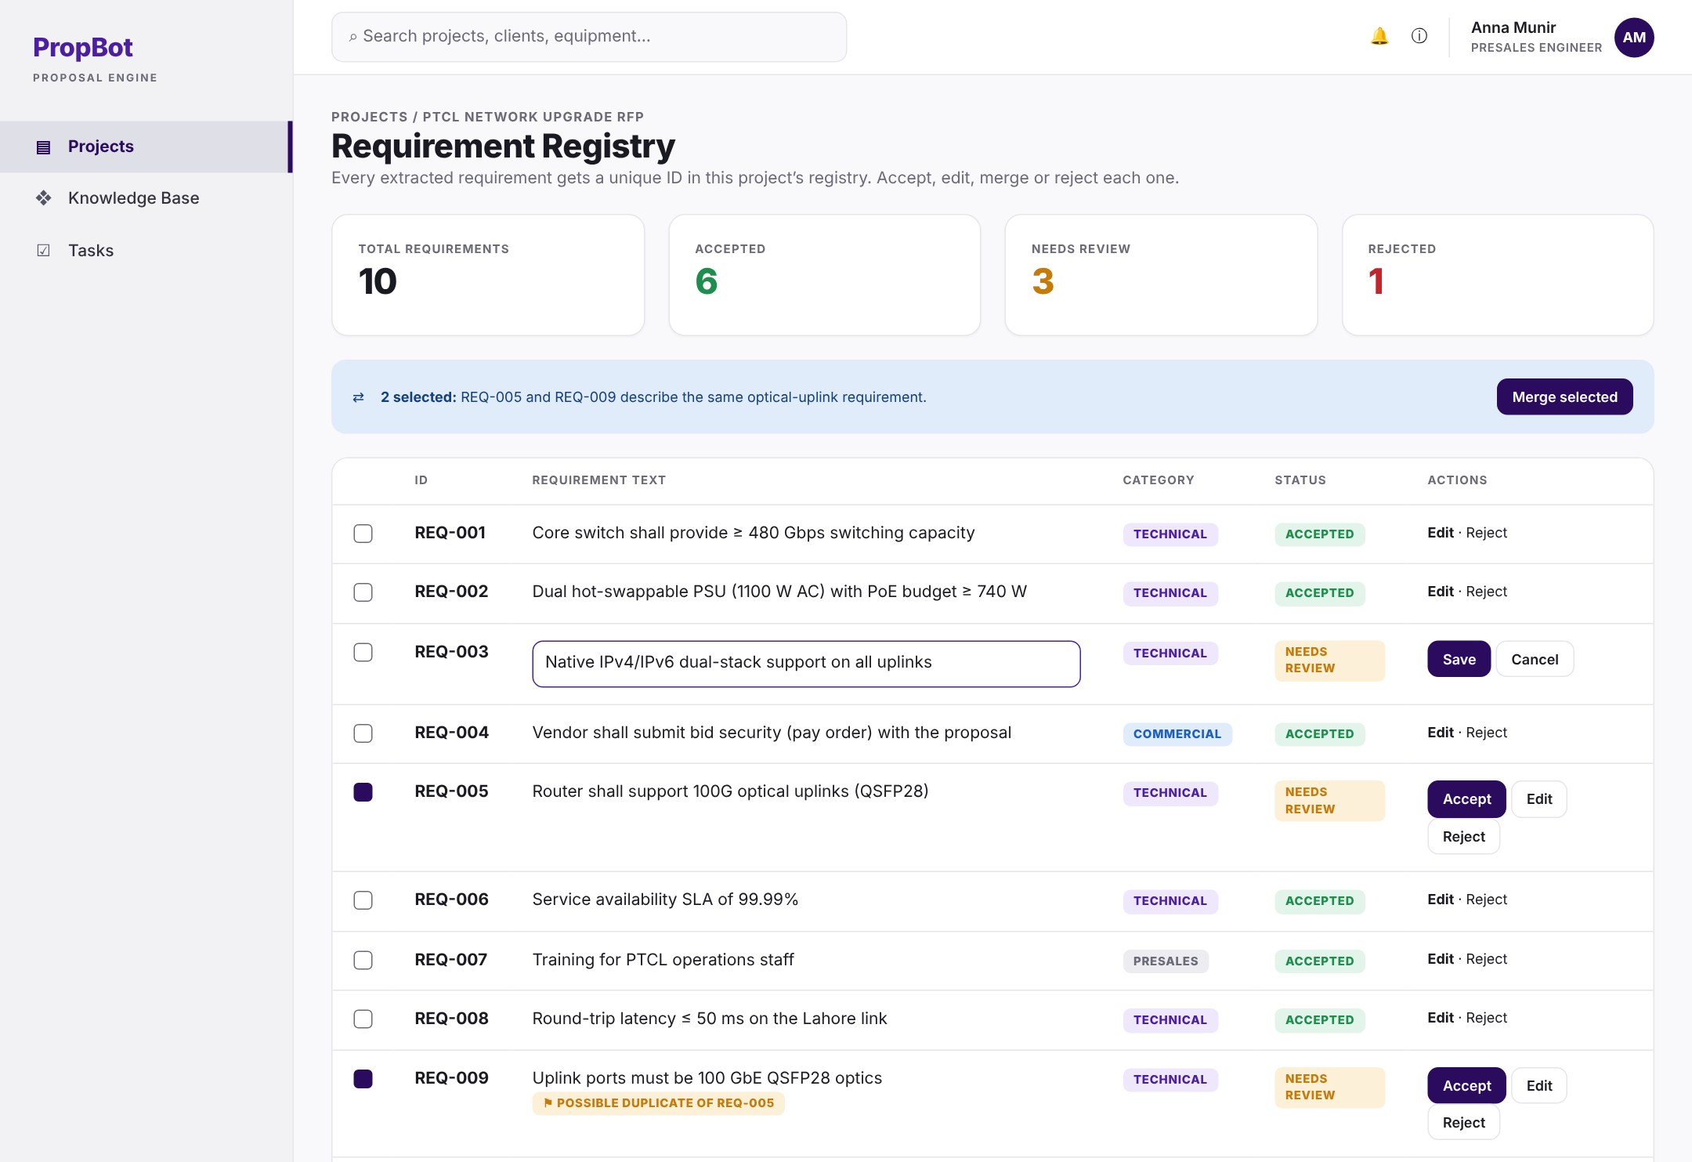
W-09 – Requirement Registry
Every extracted requirement gets an ID; the engineer accepts, edits, merges or rejects it.
FUNCTIONAL REQUIREMENT
BUSINESS RULE
1
FR-1.10 · Requirement Registry
Each requirement gets an ID; accept, edit, merge, reject
IDs are unique per project; the engineer decides each one: accept, edit, merge or reject.
1
2
FR-1.11 · Vague/Duplicate Flags
Flags vague or duplicate requirements (optional)
Optional feature. Flags are advice only; the engineer decides.
2
Use case: Extract Requirements ■ rule from the SRS ■ condition stated in the FR
PropBot · SRS Presentation 33
← Back
Contents
Module
Use case
Next →

Slide 33
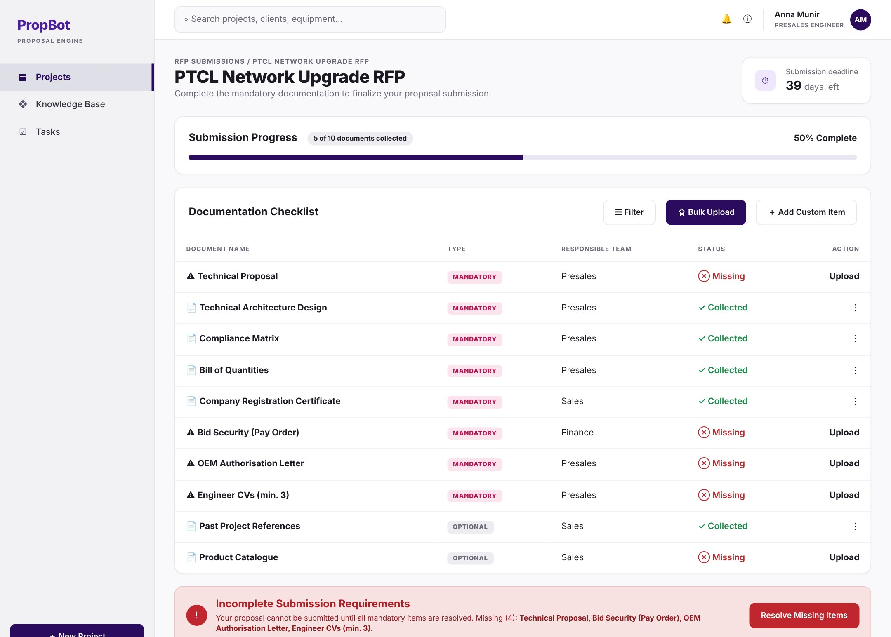
W-11 – Submission Checklist
All documents the RFP asks for, marked mandatory or optional; tick an item and attach its file.
FUNCTIONAL REQUIREMENT
BUSINESS RULE
1
FR-2.1 · Checklist Item Extraction
GPT-4o-mini lists every required submission document
Each item has a name, a mandatory flag and a team.
5
2
FR-2.2 · Mandatory or Optional
shall, must, should → mandatory; may → optional
shall / must / should → mandatory; may → optional. Engineer can change it.
1
3
2
4
FR-2.3 · Responsible Team
Assigns the presales, sales or finance team
Team is presales, sales or finance.
3
4
FR-2.4 · Checklist Tick-Off
Mark an item collected and attach its file
Ticking an item attaches its file.
5
FR-2.5 · Collected Counter
Live count of collected vs outstanding items
Counter updates on every tick-off.
6
6
FR-2.6 · Submission Blocking
No package while a mandatory item is missing
Blocking is enforced on the server, not only in the UI.
Use case: Manage Checklist (+ Extract Checklist Items) ■ rule from the SRS ■ condition stated in the FR
PropBot · SRS Presentation 34
← Back
Contents
Module
Use case
Next →

Slide 34
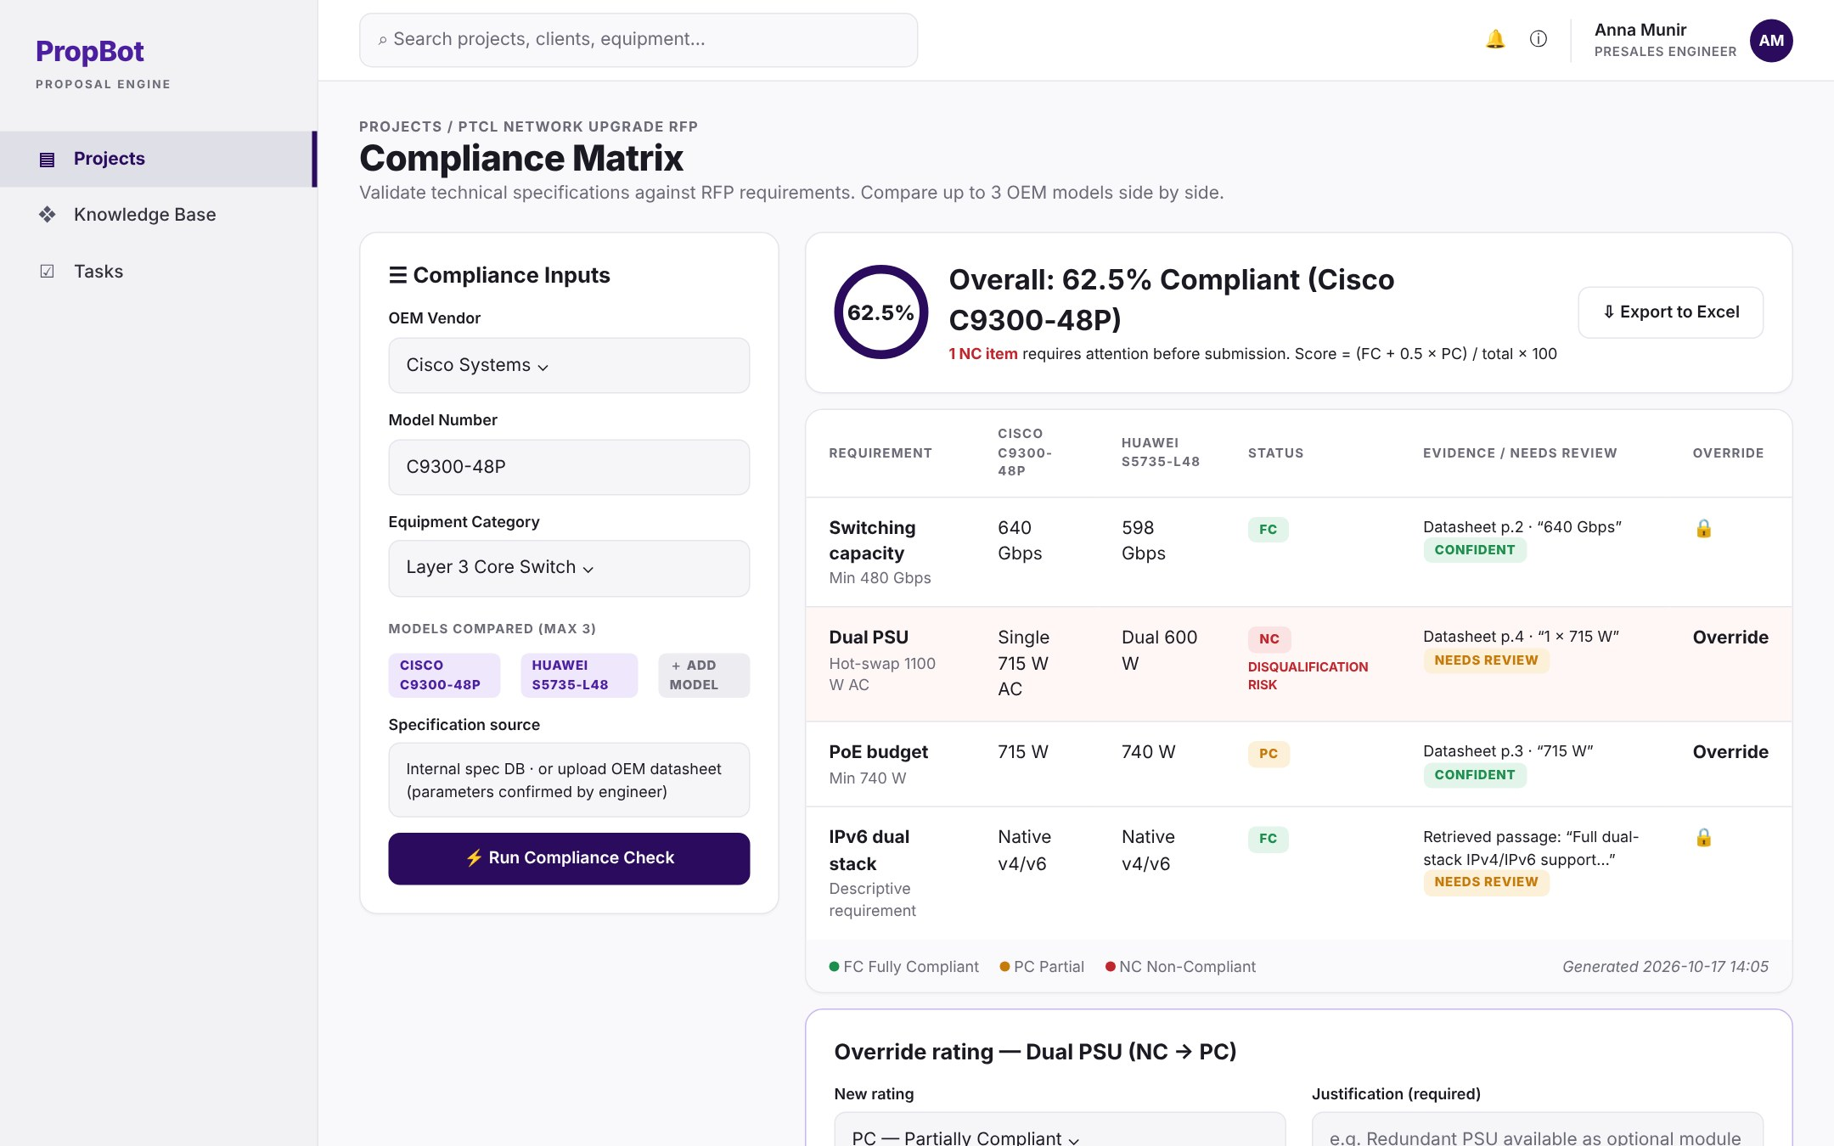
W-14 – Compliance Matrix (1/2)
The rule engine’s results: FC, PC or NC for each requirement, with the reason and the evidence.
FUNCTIONAL REQUIREMENT
BUSINESS RULE
1
FR-3.1 · Proposed Equipment Entry
Engineer enters OEM vendors and model numbers
Entered per equipment category found in Module 1.
1
3
2
FR-3.3 · Rule-Based Evaluation
Constraint check with unit conversion → FC, PC or NC
FC fully met · PC short by ≤ 10% or optional module · NC not met or missing.
2
3
FR-3.4 · Compliance Percentage
(FC + 0.5 × PC) ÷ rows × 100, for each model
Fixed formula, calculated separately for each model.
4
4
FR-3.5 · NC Highlighting
NC items in red with a disqualification-risk label
Every NC row carries a disqualification-risk label.
5
5
FR-3.6 · Manual Override
Change any rating, with a required justification
A justification note is mandatory for every override.
Use case: Generate Compliance Matrix (+ Rate Compliance, Calculate Score) ■ rule from the SRS ■ condition stated in the FR
PropBot · SRS Presentation 35
← Back
Contents
Module
Use case
Next →

Slide 35
W-14 – Compliance Matrix (2/2)
The rule engine’s results: FC, PC or NC for each requirement, with the reason and the evidence.
FUNCTIONAL REQUIREMENT
BUSINESS RULE
1
FR-3.7 · Matrix Export
Exports the matrix as an Excel (.xlsx) file
Export is a formatted .xlsx file.
1
2
FR-3.8 · Multi-Model Comparison
Compares up to 3 OEM models side by side
Maximum three models compared at once.
2
4
FR-3.9 · Descriptive Matching
Embedding search + reranking finds datasheet evidence
Only for non-constraint requirements; the top-ranked passage is the evidence.
3
3
4
FR-3.10 · Evidence and Review Flag
Keeps reason and evidence; weak rows “needs review”
“Needs review” when match score < 0.5 or no evidence is found.
Use case: Generate Compliance Matrix (+ Rate Compliance, Calculate Score) ■ rule from the SRS ■ condition stated in the FR
PropBot · SRS Presentation 36
← Back
Contents
Module
Use case
Next →

Slide 36
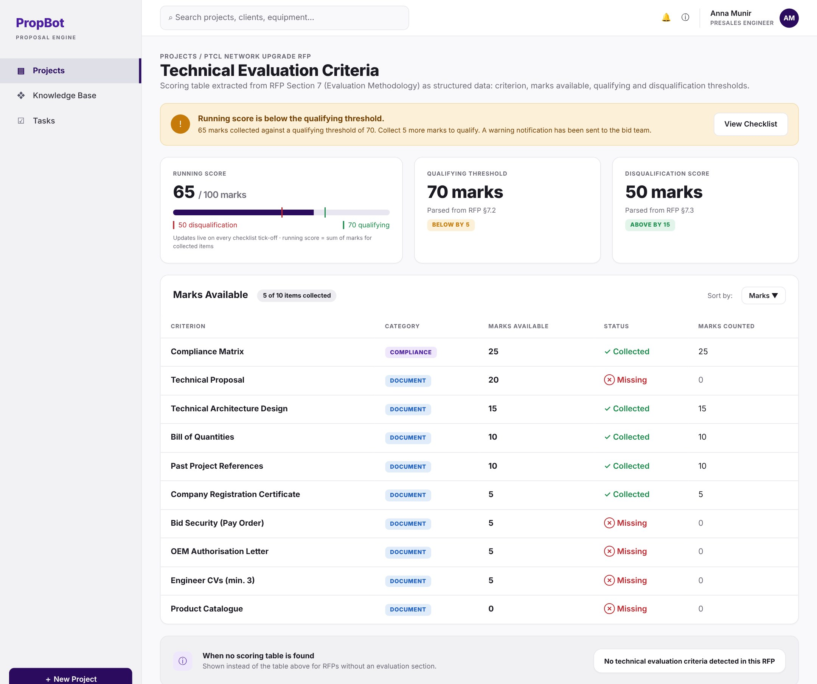
W-16 – Technical Evaluation Criteria Analyser
The RFP’s scoring table, its thresholds and our live running score.
FUNCTIONAL REQUIREMENT
BUSINESS RULE
1
1
FR-4.1 · Scoring Table Extraction
Reads the RFP’s scoring table into structured data
Captures criterion, marks and thresholds.
5
4
2
FR-4.2 · Marks Display
Sortable table of marks per category and requirement
Table is sortable.
3
2
FR-4.3 · Threshold Display
Shows the qualifying and disqualification scores
Thresholds come from the RFP’s scoring section.
3
4
FR-4.4 · Running Score
Live score from collected checklist items
Sum of marks of criteria whose linked checklist item is collected.
5
FR-4.5 · Below-Threshold Warning
Warns when the score falls below the qualifying mark
Shown whenever the score is below the qualifying threshold.
6
6
FR-4.6 · No-Criteria Message
Clear message when the RFP has no scoring table
Shown when no scoring table is found.
Use case: Track Evaluation Score (+ Extract Scoring Criteria) ■ rule from the SRS ■ condition stated in the FR
PropBot · SRS Presentation 37
← Back
Contents
Module
Use case
Next →

Slide 37

W-18 – HLD Diagram & Connectivity Description
The generated HLD network diagram with standard icons and a written connectivity description.
FUNCTIONAL REQUIREMENT
BUSINESS RULE
3
4
1
FR-5.3 · Topology Rendering
Draws the network diagram with Mermaid.js
Mermaid diagram generated from the device JSON.
1
2
FR-5.4 · Standard Icon Set
One fixed icon for each device type
One fixed icon each for switch, router, firewall, server, storage.
2
3
FR-5.5 · PNG Export
Exports the diagram as a PNG image
Rendered headless with Playwright.
5
4
FR-5.6 · Editable draw.io Export
Editable draw.io file (optional)
Optional feature, built only if time permits.
5
FR-5.7 · Connectivity Description
2–4 paragraphs explaining the network, by GPT-4o-mini
2–4 paragraphs written from the device graph.
Use case: Generate HLD Diagram (+ Render Topology, Describe Connectivity) ■ rule from the SRS ■ condition stated in the FR
PropBot · SRS Presentation 38
← Back
Contents
Module
Use case
Next →

Slide 38

W-20 – Proposal Review Editor
Edit each section, approve it or request changes, and see the requirement IDs it covers.
FUNCTIONAL REQUIREMENT
BUSINESS RULE
1
FR-6.7 · Section Editing
Engineer edits each section in a rich-text editor
Edited in TipTap before approval.
4
1
FR-6.8 · Reviewer Approval Gate
No export until every section is approved
Export is blocked until every section is approved.
2
3
FR-6.11 · Requirement Linking
Links each section to the requirement IDs it covers
Each section lists the requirement IDs it covers.
3
5
2
4
FR-6.12 · Coverage Check
Lists requirements not covered by any section
Lists accepted requirements with no section.
5
FR-13.3 · Self-Approval Prevention
Nobody can approve a section they generated
Enforced on the server, not only in the UI.
Use case: Approve Proposal (+ Request Changes) · Link Requirements ■ rule from the SRS ■ condition stated in the FR
PropBot · SRS Presentation 39
← Back
Contents
Module
Use case
Next →

Slide 39

W-23 – BOQ Editor
The client’s BOQ template filled from the compliance matrix; costing columns left blank.
FUNCTIONAL REQUIREMENT
BUSINESS RULE
1
FR-7.1 · BOQ Template Library
Excel templates for PTCL, OGDCL, Zong and Telenor
One template per client: PTCL, OGDCL, Zong, Telenor.
4
5
1
2
2
FR-7.2 · Auto-Population
Fills models, descriptions and quantities automatically
Values come from the compliance matrix.
3
FR-7.3 · Costing Left Blank
Cost and margin columns are left for manual entry
Costing, margin and formula columns stay blank.
3
4
FR-7.4 · Line-Item Editing
Add, edit or remove lines before export
Lines can be changed before export.
5
FR-7.5 · BOQ Export
Exports the completed BOQ as .xlsx
Export is an .xlsx file.
Use case: Generate BOQ (+ Import Equipment, Apply BOQ Template) ■ rule from the SRS ■ condition stated in the FR
PropBot · SRS Presentation 40
← Back
Contents
Module
Use case
Next →

Slide 40
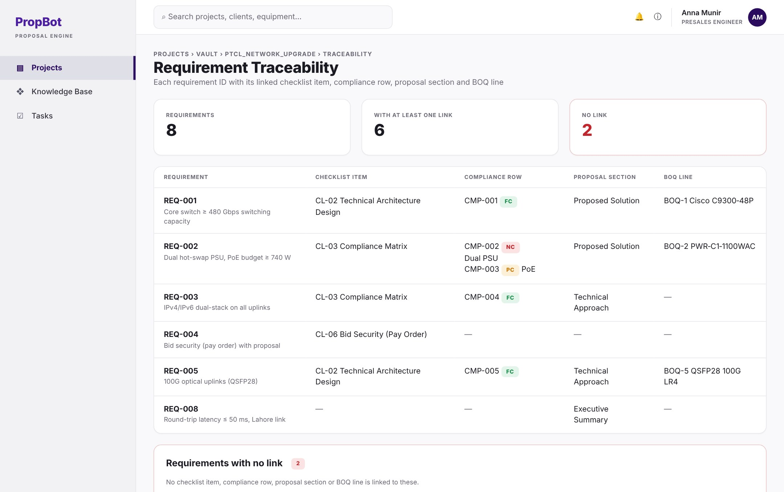
W-27 – Requirement Traceability View
For each requirement ID: its checklist item, compliance row, proposal section and BOQ line, plus any gaps.
FUNCTIONAL REQUIREMENT
BUSINESS RULE
1
FR-9.7 · Traceability View
Shows each requirement’s links and any gaps
Requirements with no link are listed separately.
1
Use case: Search Project Vault ■ rule from the SRS ■ condition stated in the FR
PropBot · SRS Presentation 41
← Back
Contents
Module
Use case
Next →

Slide 41
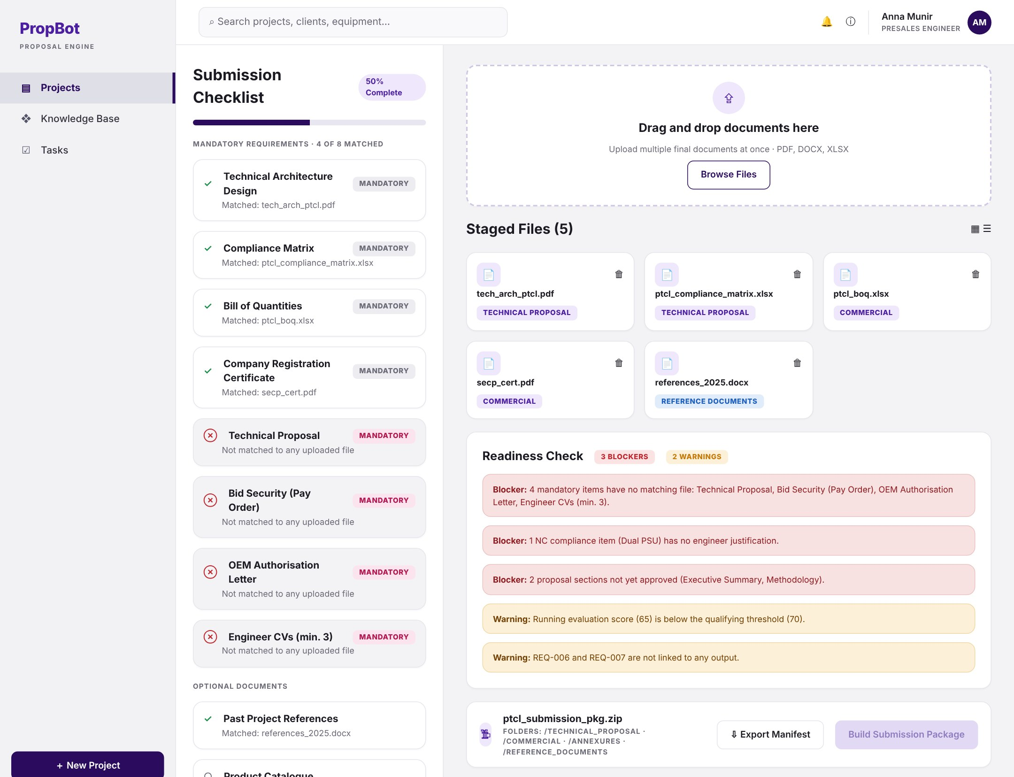
W-28 – Submission Package Builder
Uploaded files matched to the checklist; the readiness check lists blockers and warnings.
FUNCTIONAL REQUIREMENT
BUSINESS RULE
1
FR-10.1 · Multi-File Upload
Upload all final submission documents at once
Several files can be uploaded at once.
1
2
2
FR-10.2 · Checklist Cross-Check
Matches uploaded files to checklist items
Matched checklist items are marked fulfilled.
3
FR-10.3 · Blocking Error List
Lists mandatory items that are still missing
Shown before packaging starts.
3
5
4
FR-10.4 · ZIP Generation
Builds the ZIP with a standard folder structure
ZIP always uses four standard folders.
4
FR-10.7 · Readiness Check
Blockers stop packaging; warnings are only shown
Blockers stop the ZIP; warnings are only shown.
5
Use case: Build Submission Package (+ Match Files, Check Readiness) ■ rule from the SRS ■ condition stated in the FR
PropBot · SRS Presentation 42
← Back
Contents
Module
Use case
Next →

Slide 42
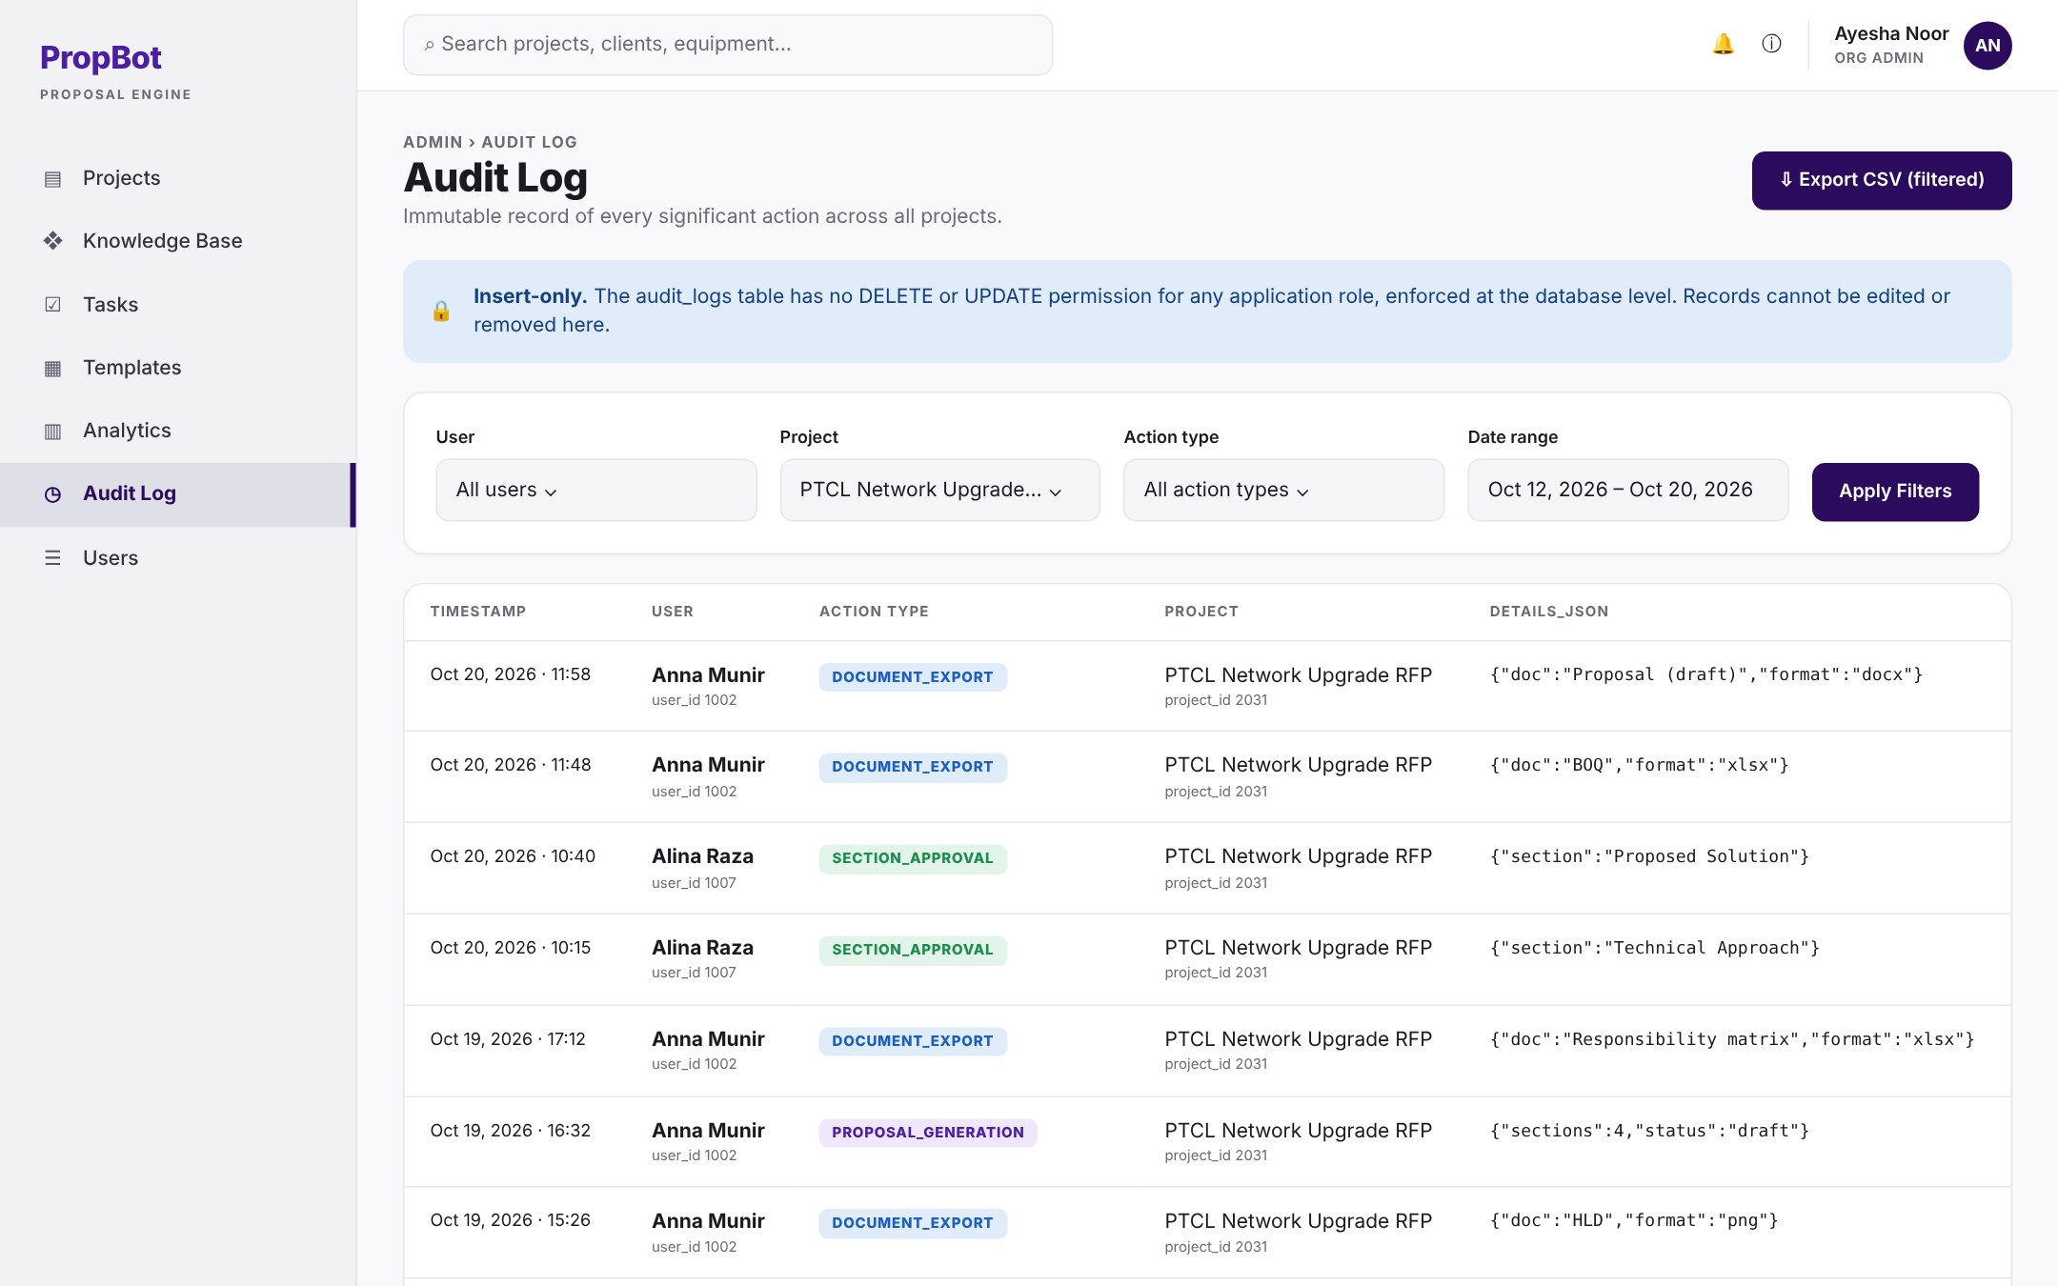
W-41 – Audit Log
Every important action recorded, filterable and exportable; records can never be edited.
FUNCTIONAL REQUIREMENT
BUSINESS RULE
1
FR-15.1 · Audit Record
Every important action is recorded
Every significant action is recorded.
1
5
4
2
FR-15.2 · Audit Record Fields
Who, what, which project, when, and details
Stores user, action, project, time and details_json.
3
2
3
FR-15.3 · Audit Log Filtering
Filter by user, project, action and date
Filter by user, project, action and date.
4
FR-15.4 · Insert-Only Records
Records can never be edited or deleted
No UPDATE or DELETE, enforced by the database.
5
FR-15.5 · CSV Export
Export the filtered log as a CSV file
Exports the filtered log as CSV.
Use case: View Audit Log ■ rule from the SRS ■ condition stated in the FR
PropBot · SRS Presentation 43
← Back
Contents
Module
Use case
Next →

Slide 43
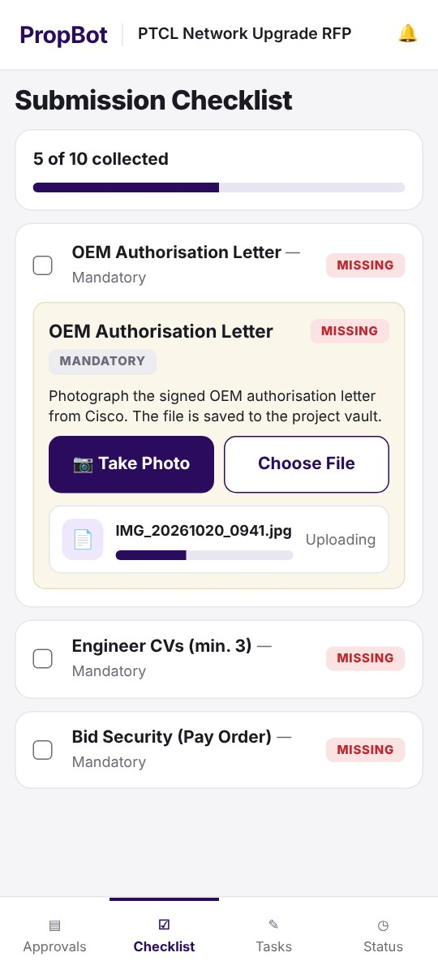
M-03 · M-07 – Mobile Approvals and Document Capture
Reviewers approve on the phone; engineers capture checklist documents with the camera.
FUNCTIONAL REQUIREMENT
BUSINESS RULE
1
FR-18.3 · Mobile Proposal Review
Approve or request changes from the phone
Self-approval block (FR-13.3) also applies on mobile.
2
FR-18.4 · Document Capture
Photo or file attached to a checklist item
File is stored in the project vault.
2
1
Use case: Approve Proposal · Manage Checklist ■ rule from the SRS ■ condition stated in the FR
PropBot · SRS Presentation 44
← Back
Contents
Module
Use case
Next →

Slide 44
NON-FUNCTIONAL REQUIREMENTS ·
Non-Functional Requirements
Performance
Fast enough to use during a bid
Security
Roles, isolation, safe uploads
Sections shown in 60 s; full extraction in 180 s (100-page text RFP)
Compliance for 100 rows × 3 models in 30 s
4-section proposal in 60 s (parallel calls); vault search in 3 s
Login and token checks in 500 ms with 20 users
5 roles; a refused request returns no data; companies fully isolated
No self-approval, even if the UI is bypassed
Lockout after 5 failed logins in 15 min; rate limits
Uploads type-checked and virus-scanned (ClamAV); HTTPS with TLS 1.2+
Usability
Easy to act on
Reliability
Recoverable and fail-safe
One click or tap to mark a checklist item collected
Status is never shown by colour alone (FC / PC / NC labels)
Progress shown for any task longer than 5 s
Mobile shows only the functions of the user’s role
99% uptime in office hours; automatic restart within 5 min
Daily backups kept 14 days; RPO 24 h, RTO 4 h
A failed AI step never overwrites saved work
OpenAI outage: error and retry; non-AI features keep working
PropBot · SRS Presentation 45
← Back
Contents
Next →

Slide 45
PROPBOT · SRS PRESENTATION
Thank you
Contents
Use case diagram
Questions are welcome
Key mockups
Alina Raza · Anna Munir · Ayesha Noor
Supervisor: Dr. Memoona Malik
Modules

